Slide 1

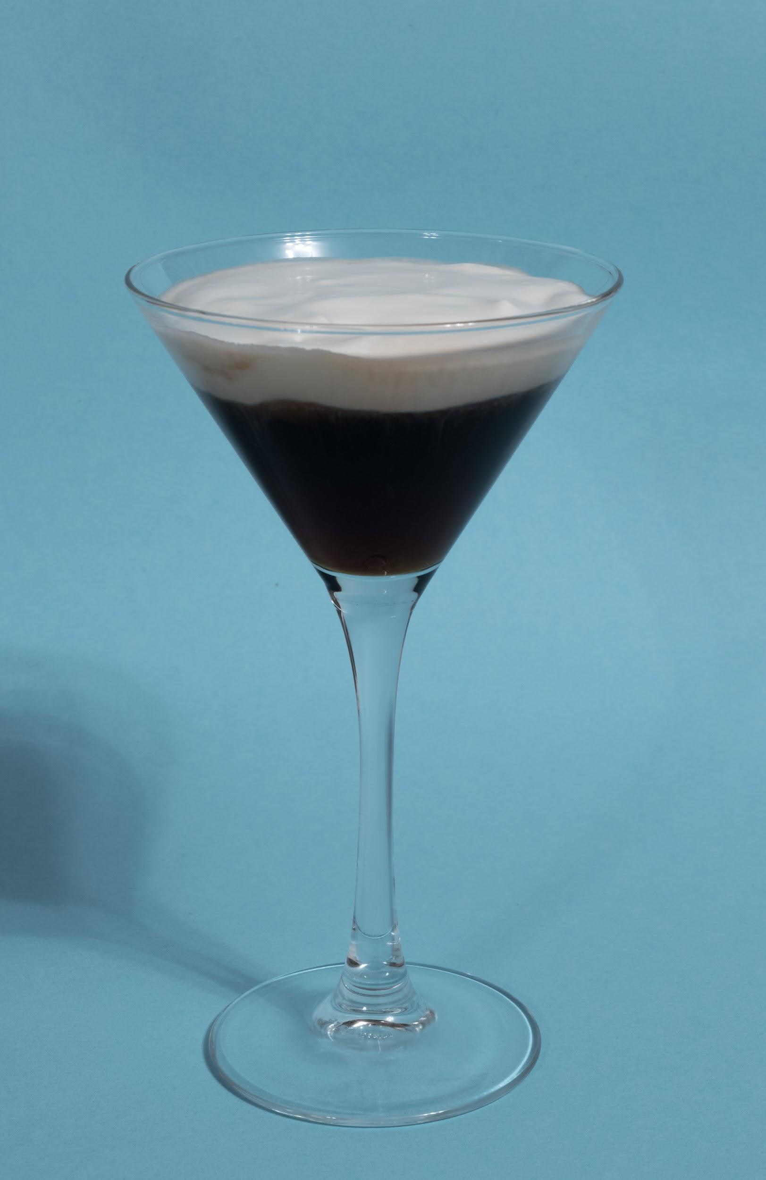
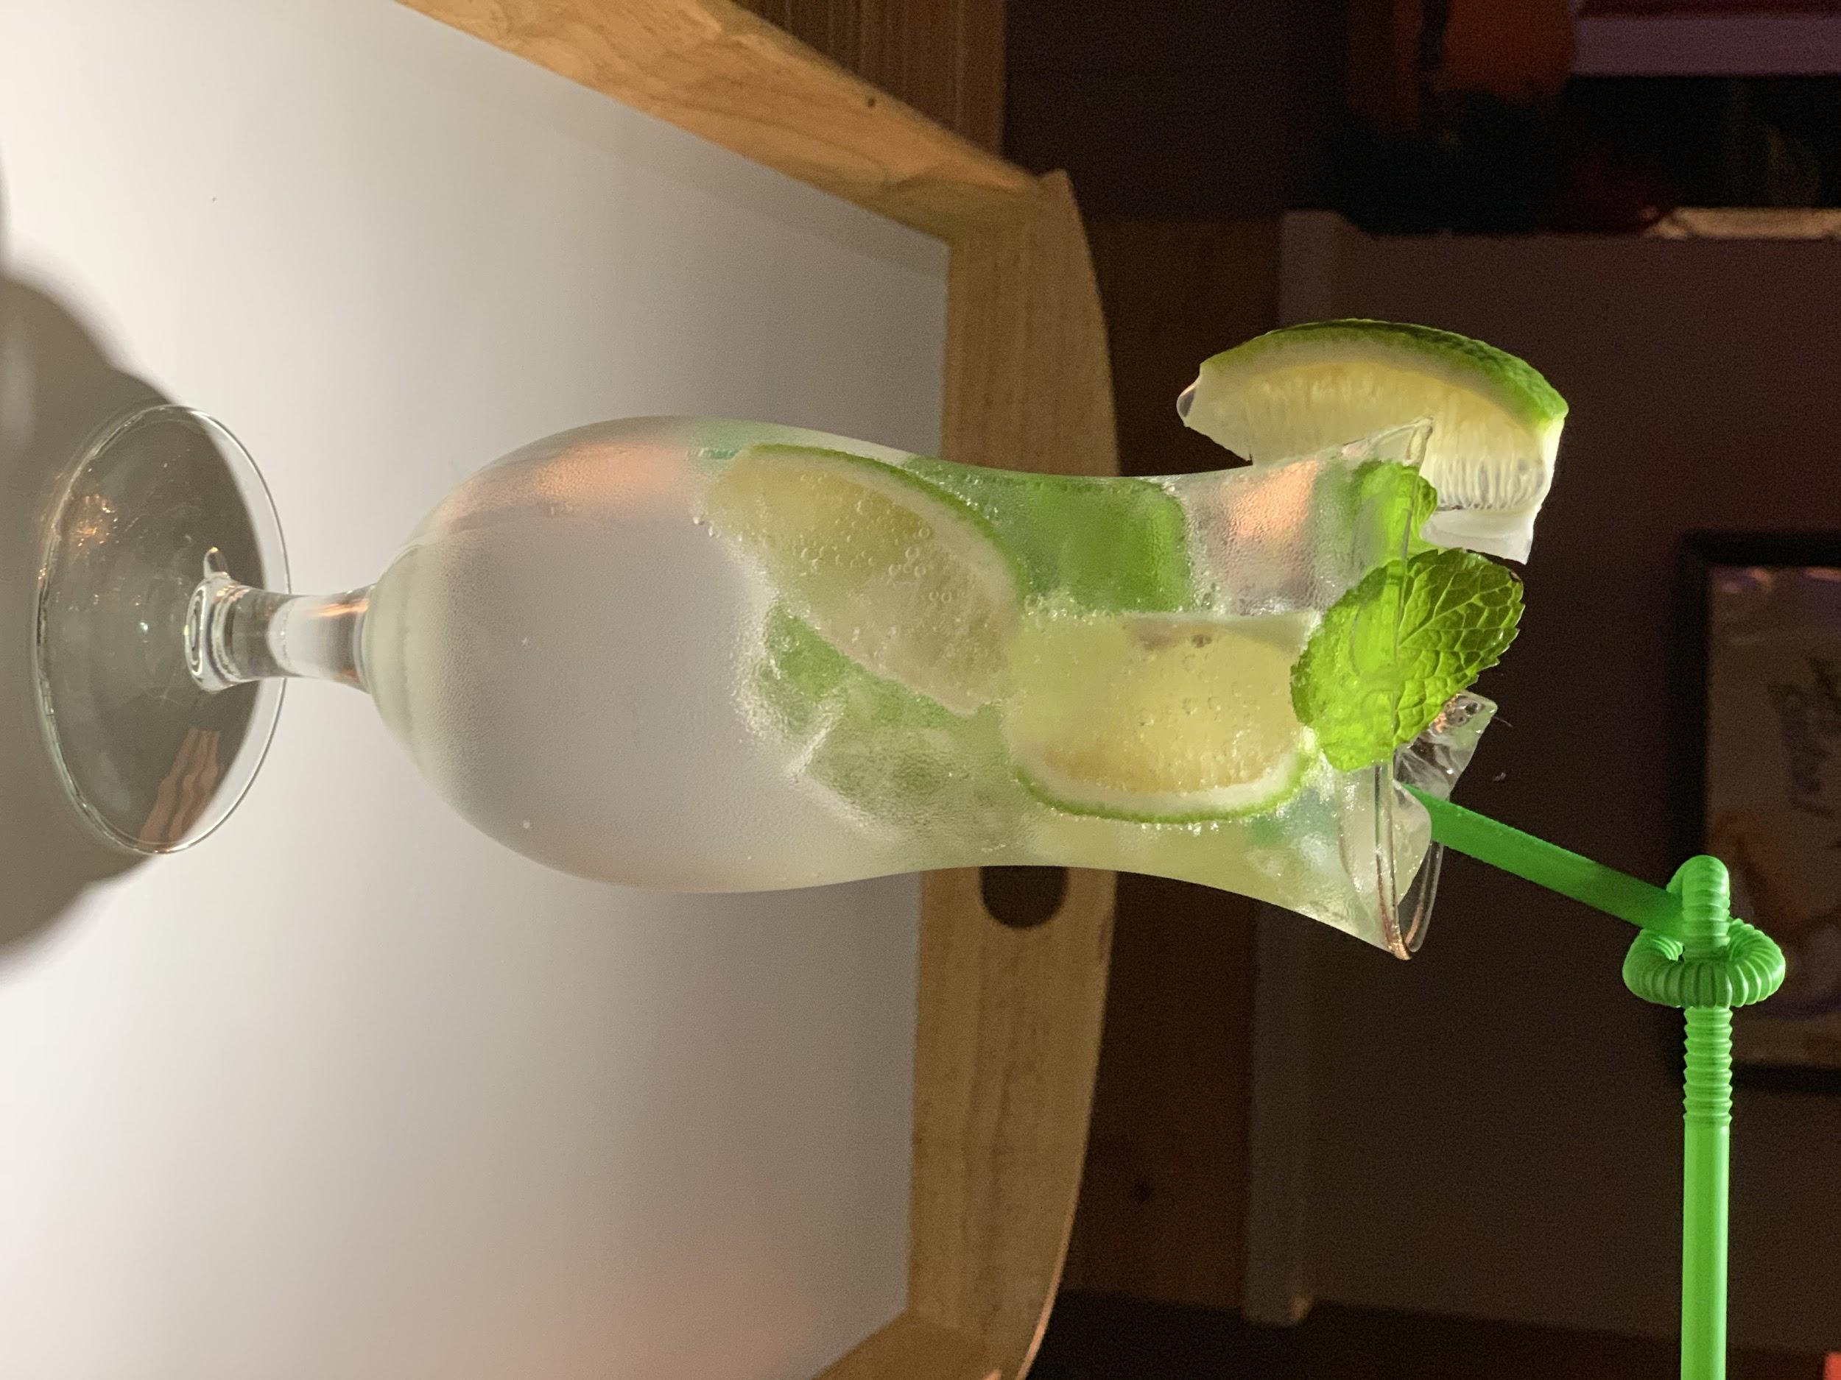
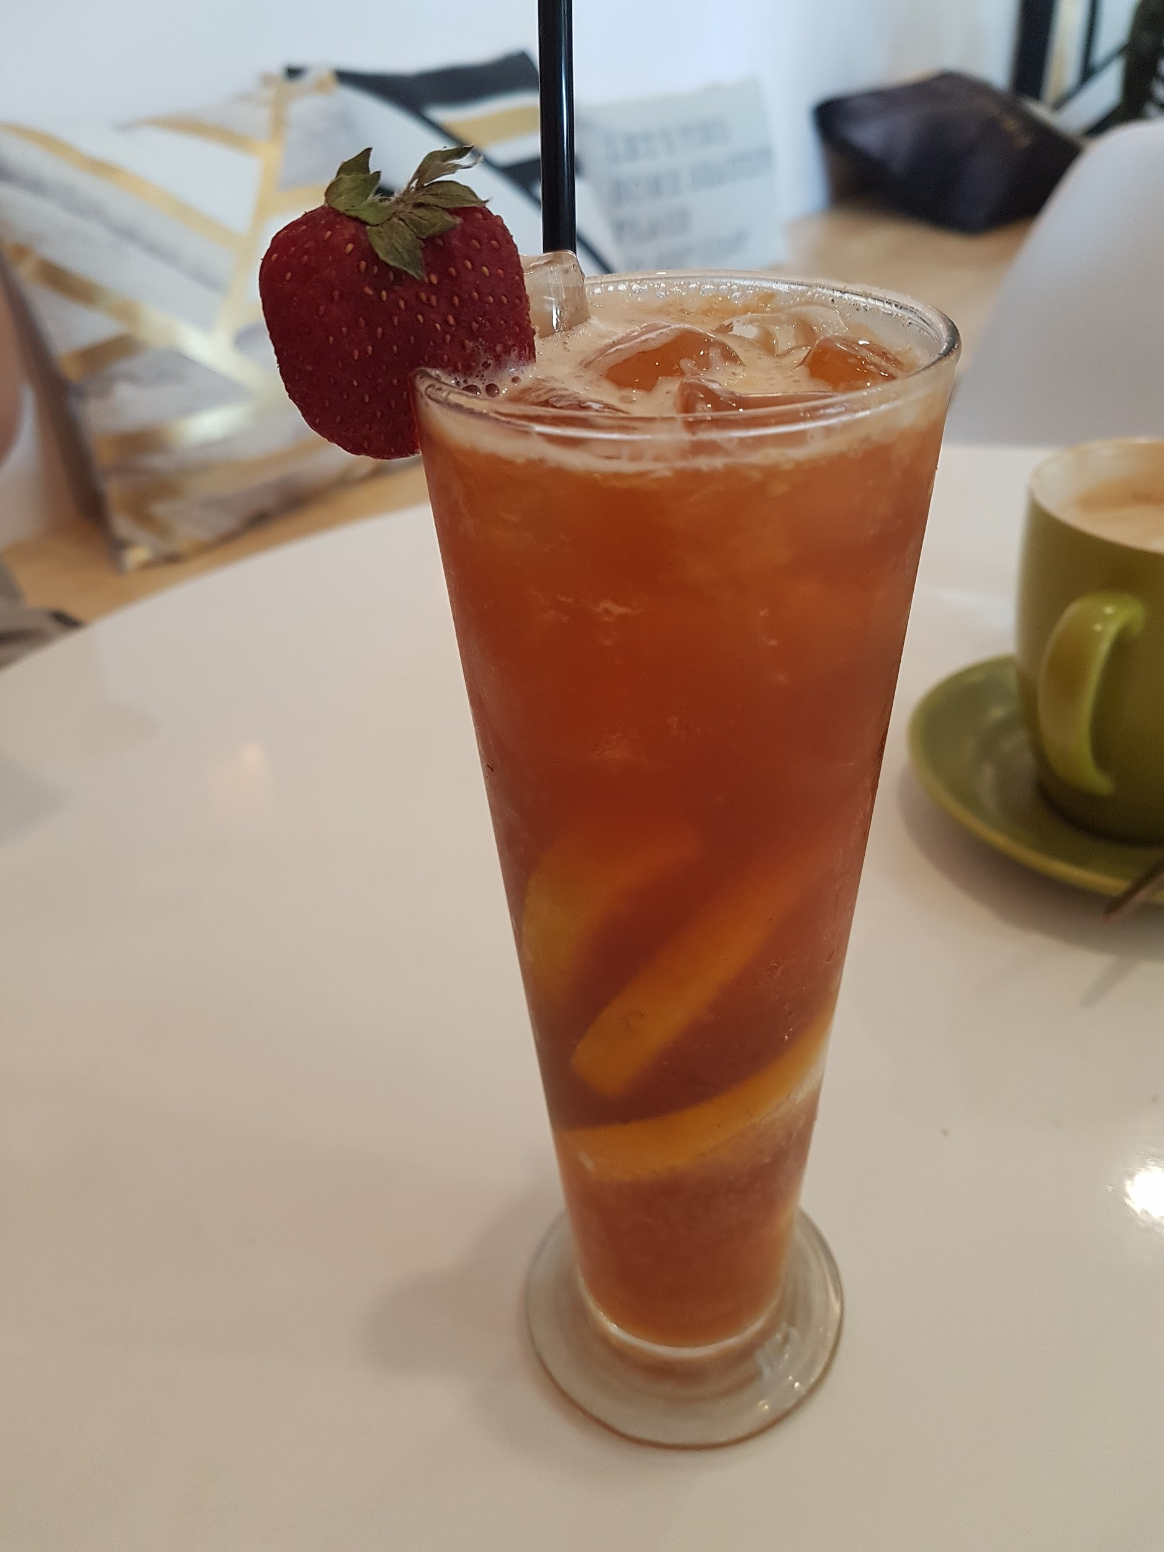

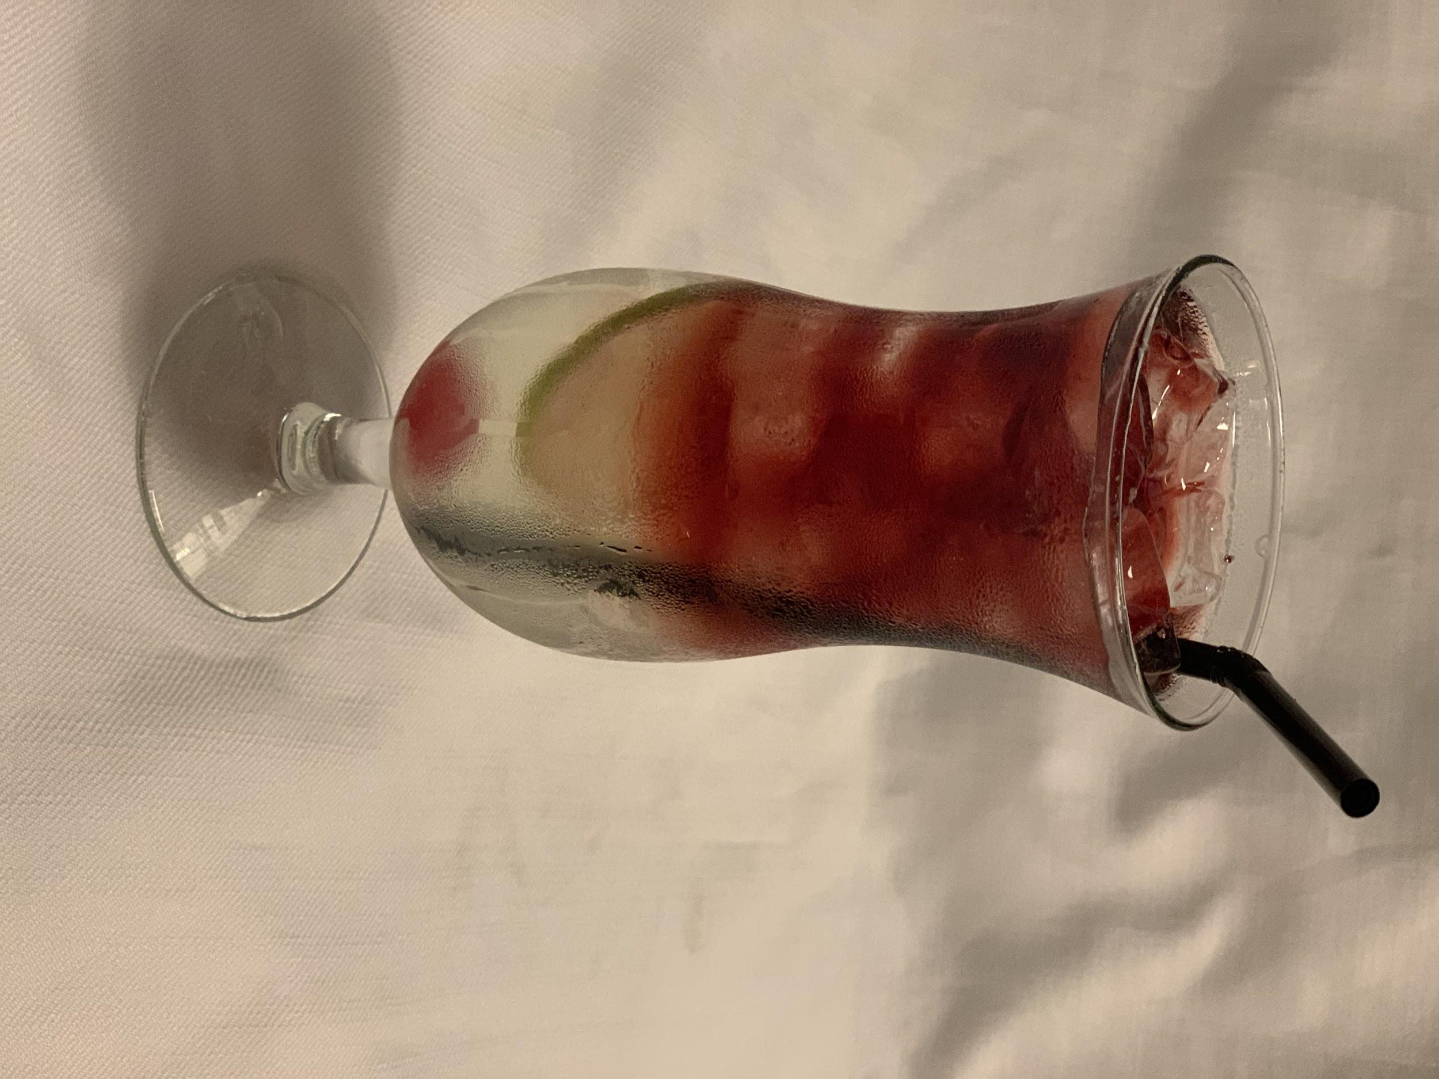
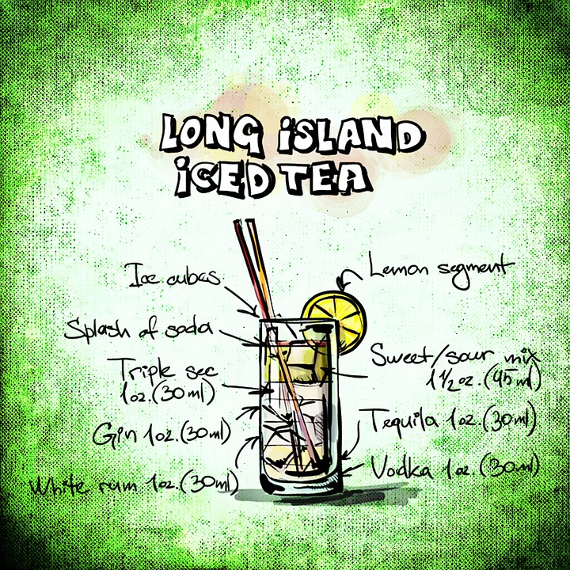
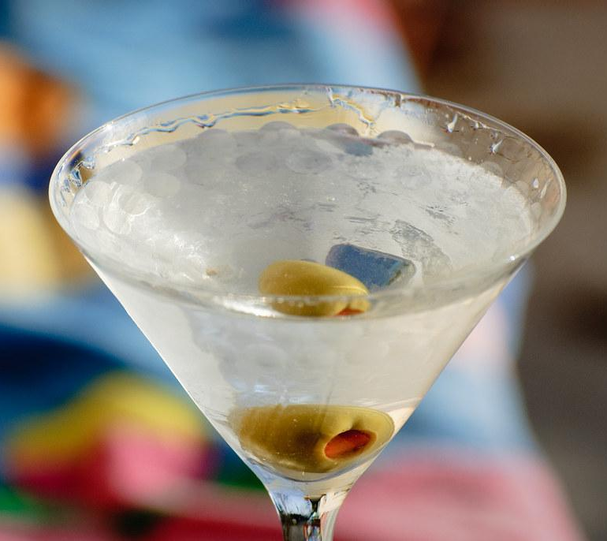
Coffee martini 咖啡馬丁尼$290
A shot of espresso mixed with a shot of vodka served chilled. Made to be sipped
Or get a bit groovy and try it with a shot of sambuca
咖啡+伏特加or杉布卡
Pisco sour 皮斯可特調$290
Get a taste of the Andes
Try a pisco sour from Peru
皮斯可酒+檸檬+蛋白
Fruit tea cocktail 微醺水果茶$290
A fruit tea with a twist of
gin and cointreau
水果茶+琴酒+君度橙酒
Long island iced wine tea $360
長島冰茶/長島落日
Or long island iced tea Vodka, tequila, gin, triple sec, rum
And topped off with red wine Not for the faint of heart
伏特加+琴酒+柑橘酒+萊姆酒+檸檬汁+龍舌蘭/紅酒
Martini 馬丁尼$280
Quality gin and bianco Stirred or
shaken Thank you Mr Bond
琴酒+白香艾酒
Plus 10% service charge

Slide 2
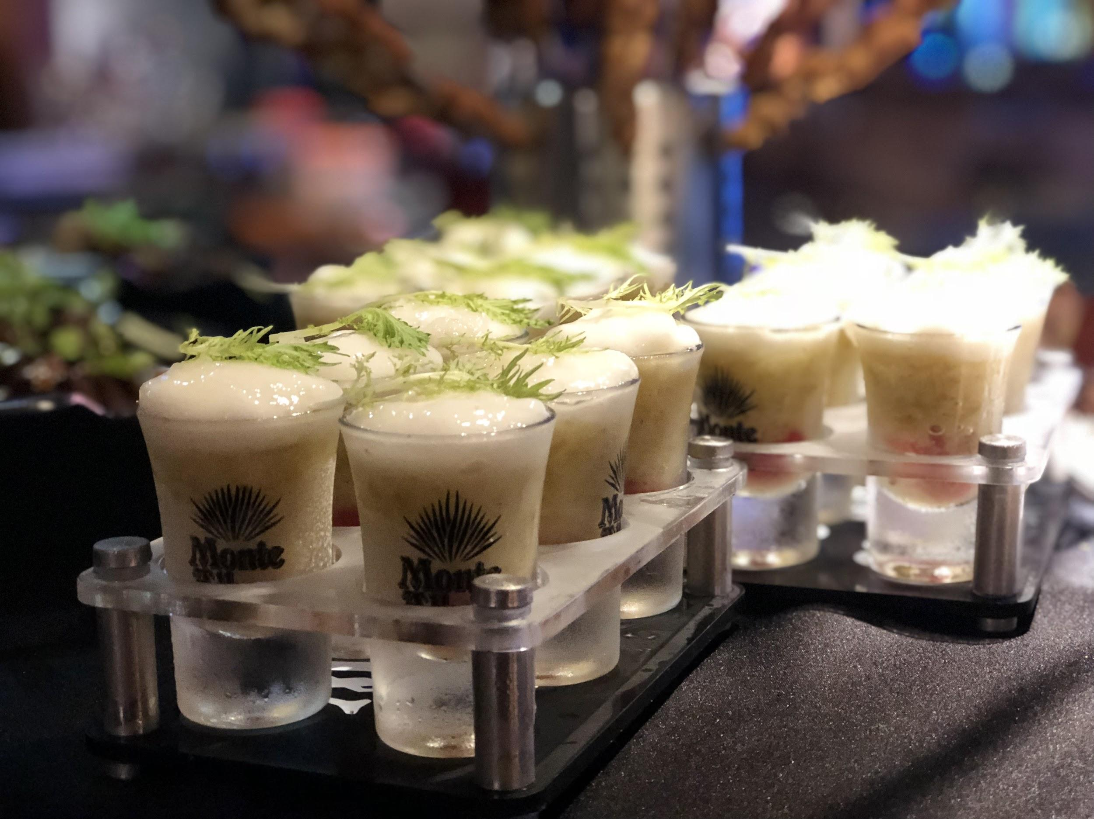
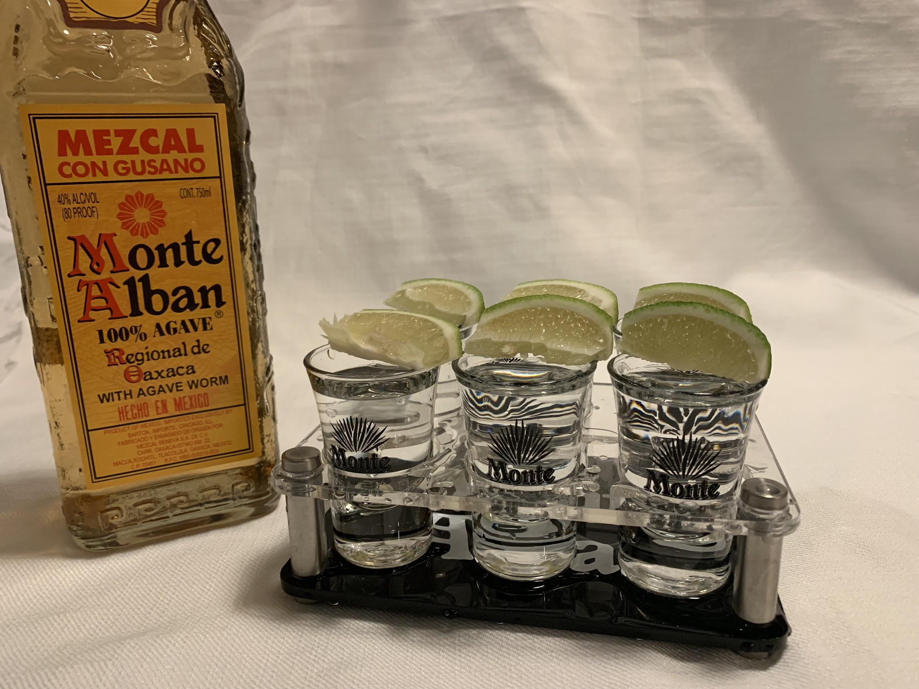
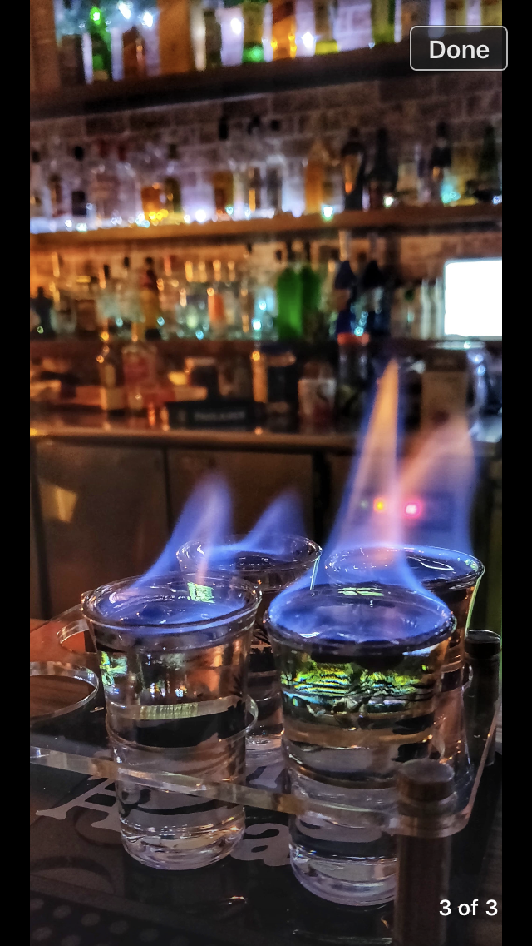
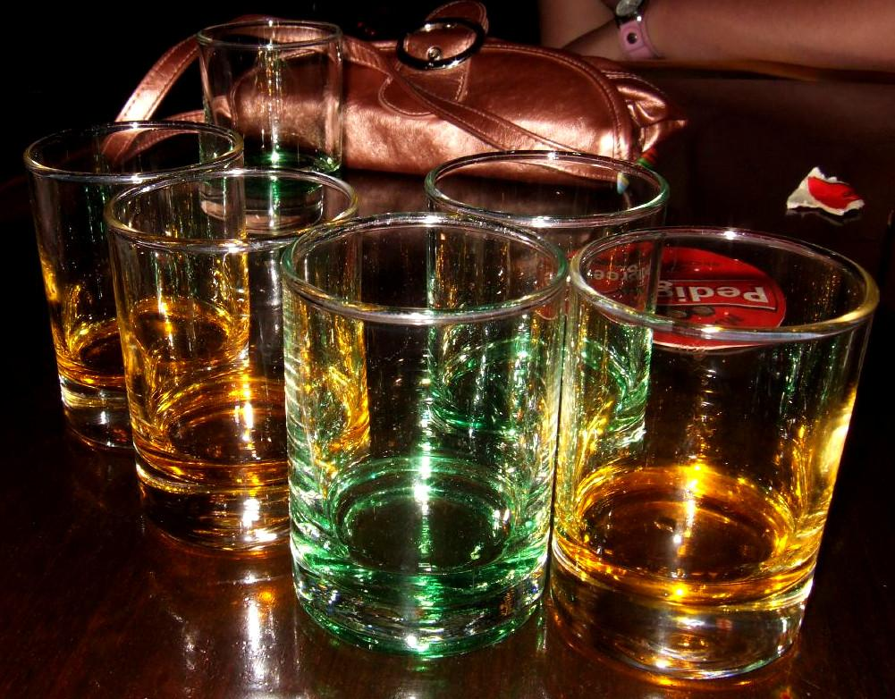
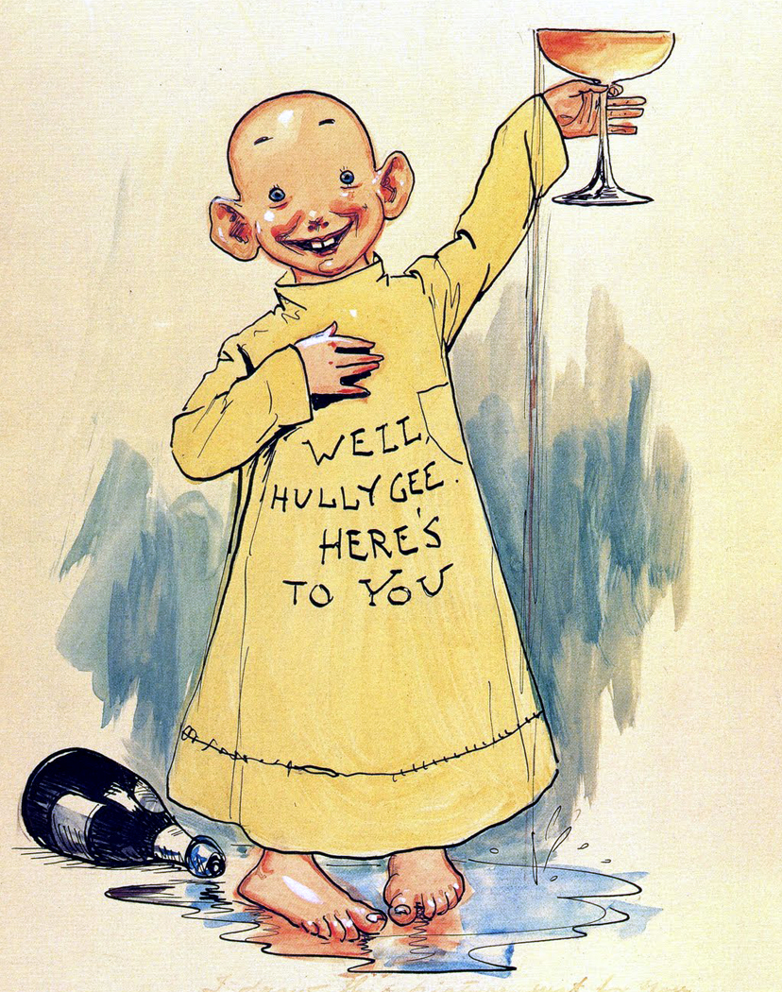

一口酒Shots by the tray(6)
6 x blow jobs 口交$590
Get more than a hand full of blow jobs
baileys, disaronno & cream
貝禮詩+杏仁酒+鮮奶油
Tequila 龍舌蘭 $490 ($140)
Take your choice of tequilas
And get your night started
Or if your game enough try a suicide shot
Ask how!
Flaming sambuca火焰杉布卡 6x$520($180)
A European delicacy to be enjoyed again and again
The summer slammer夏夜 $390
A smooth blend of quality whiskey, mixed with fresh lemon and a cooling splash of Hi C
威士忌+檸檬+HI C
Cheap shots 還想來點別的嗎?
Barbozda rum 巴巴羅薩蘭姆酒
Barska vodka 奧爾登伏特加
Tortilla tequila 金帽子龍舌蘭 6 x $350
Alden gin 奧爾登琴酒 $90 each
Plus 10% service charge 本店消費需酌收10% 服務費
Notes:
cheap shots

Slide 3

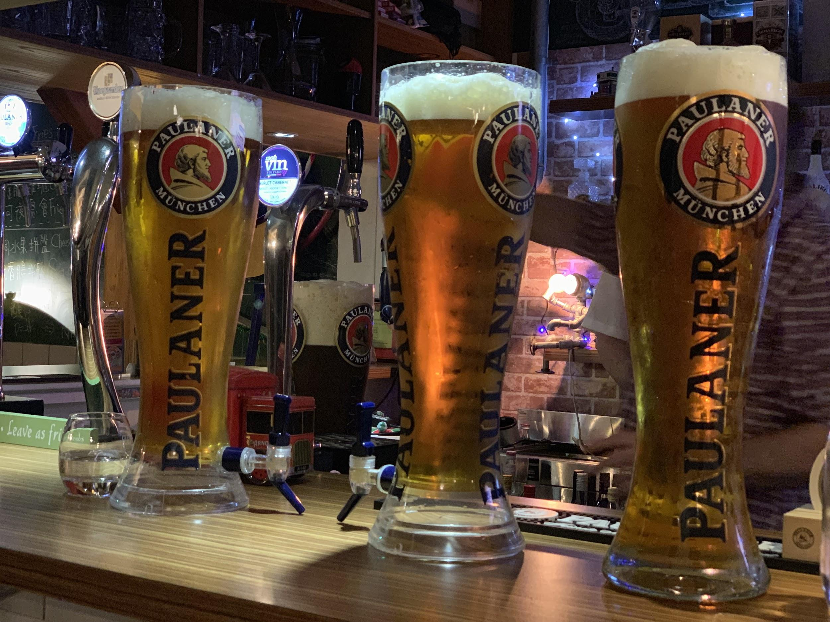
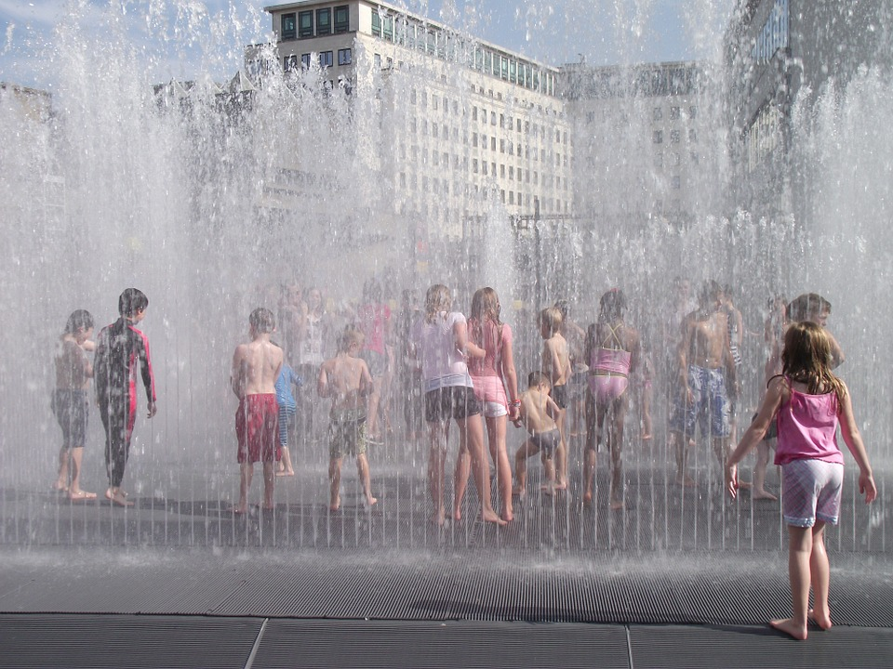

Take the Paulaner challenge
保拉納啤酒塔 等你來挑戰
Free beer
It takes just 10 minutes to earn your fame and not only will you get a cheers from the bar but you get your beer for free and a Fat Yak shirt
All you need to do is finish
your beer within 10 minutes
and it is absolutely free!
OK OK it is a 3 litre beer
But it has been done before
and if you don't finish
in time you can share
it with your friends.
限時10分鐘，只要你能
一個人喝完3公升的
保拉納啤酒塔，你的啤酒塔
就由胖犛牛請客。
喝不完？沒關係！
跟你的朋友一起分享吧。
BEER TOWER PAULANER
保拉納啤酒塔 $1200

Slide 4
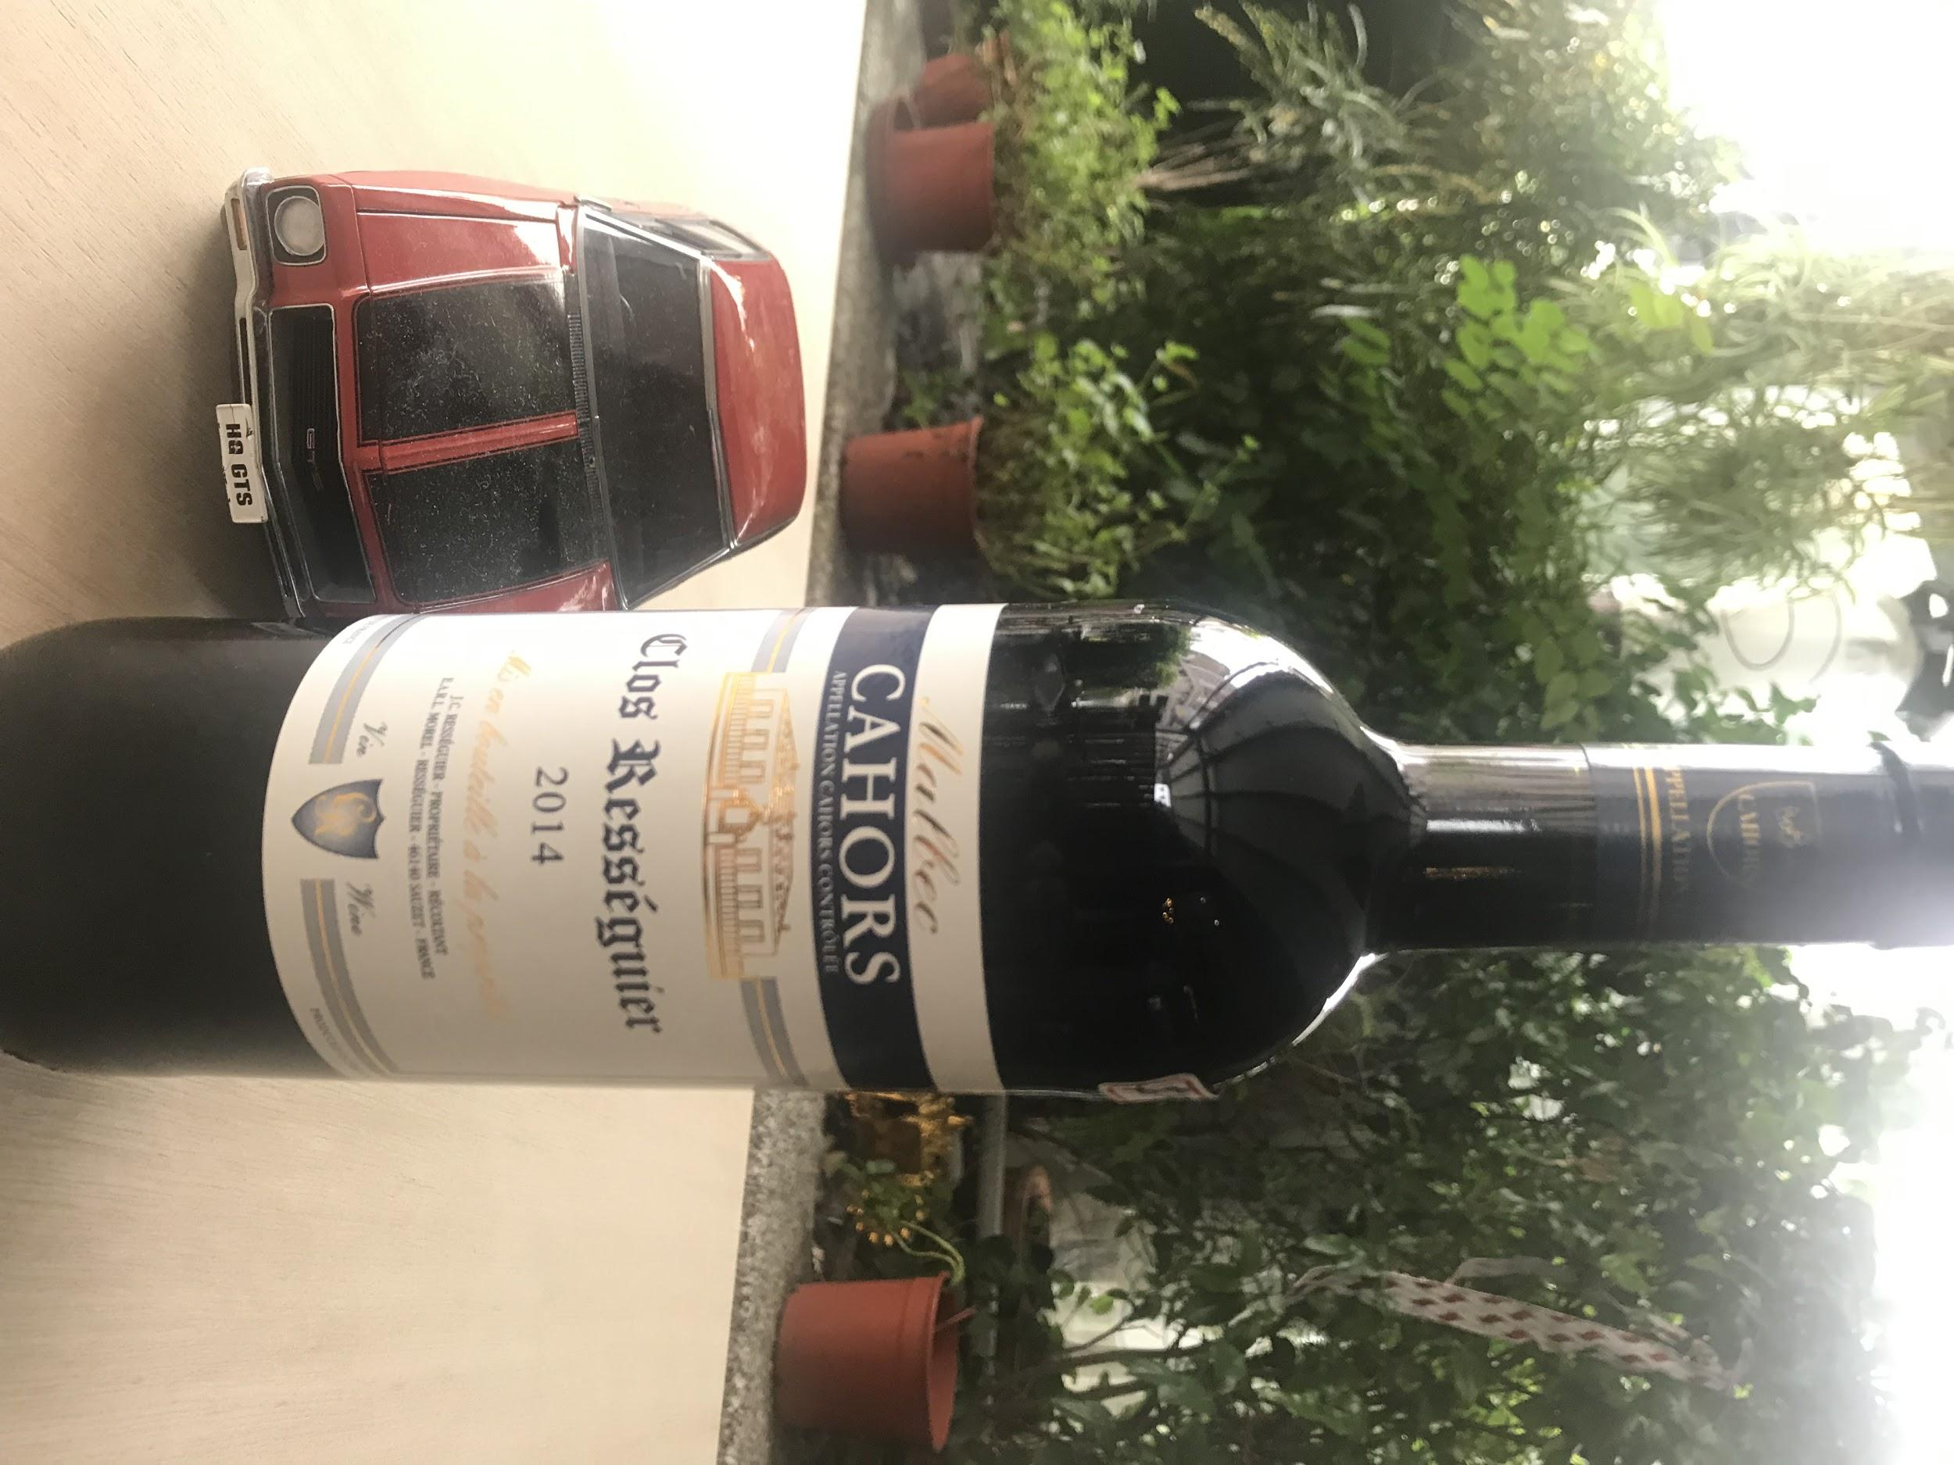
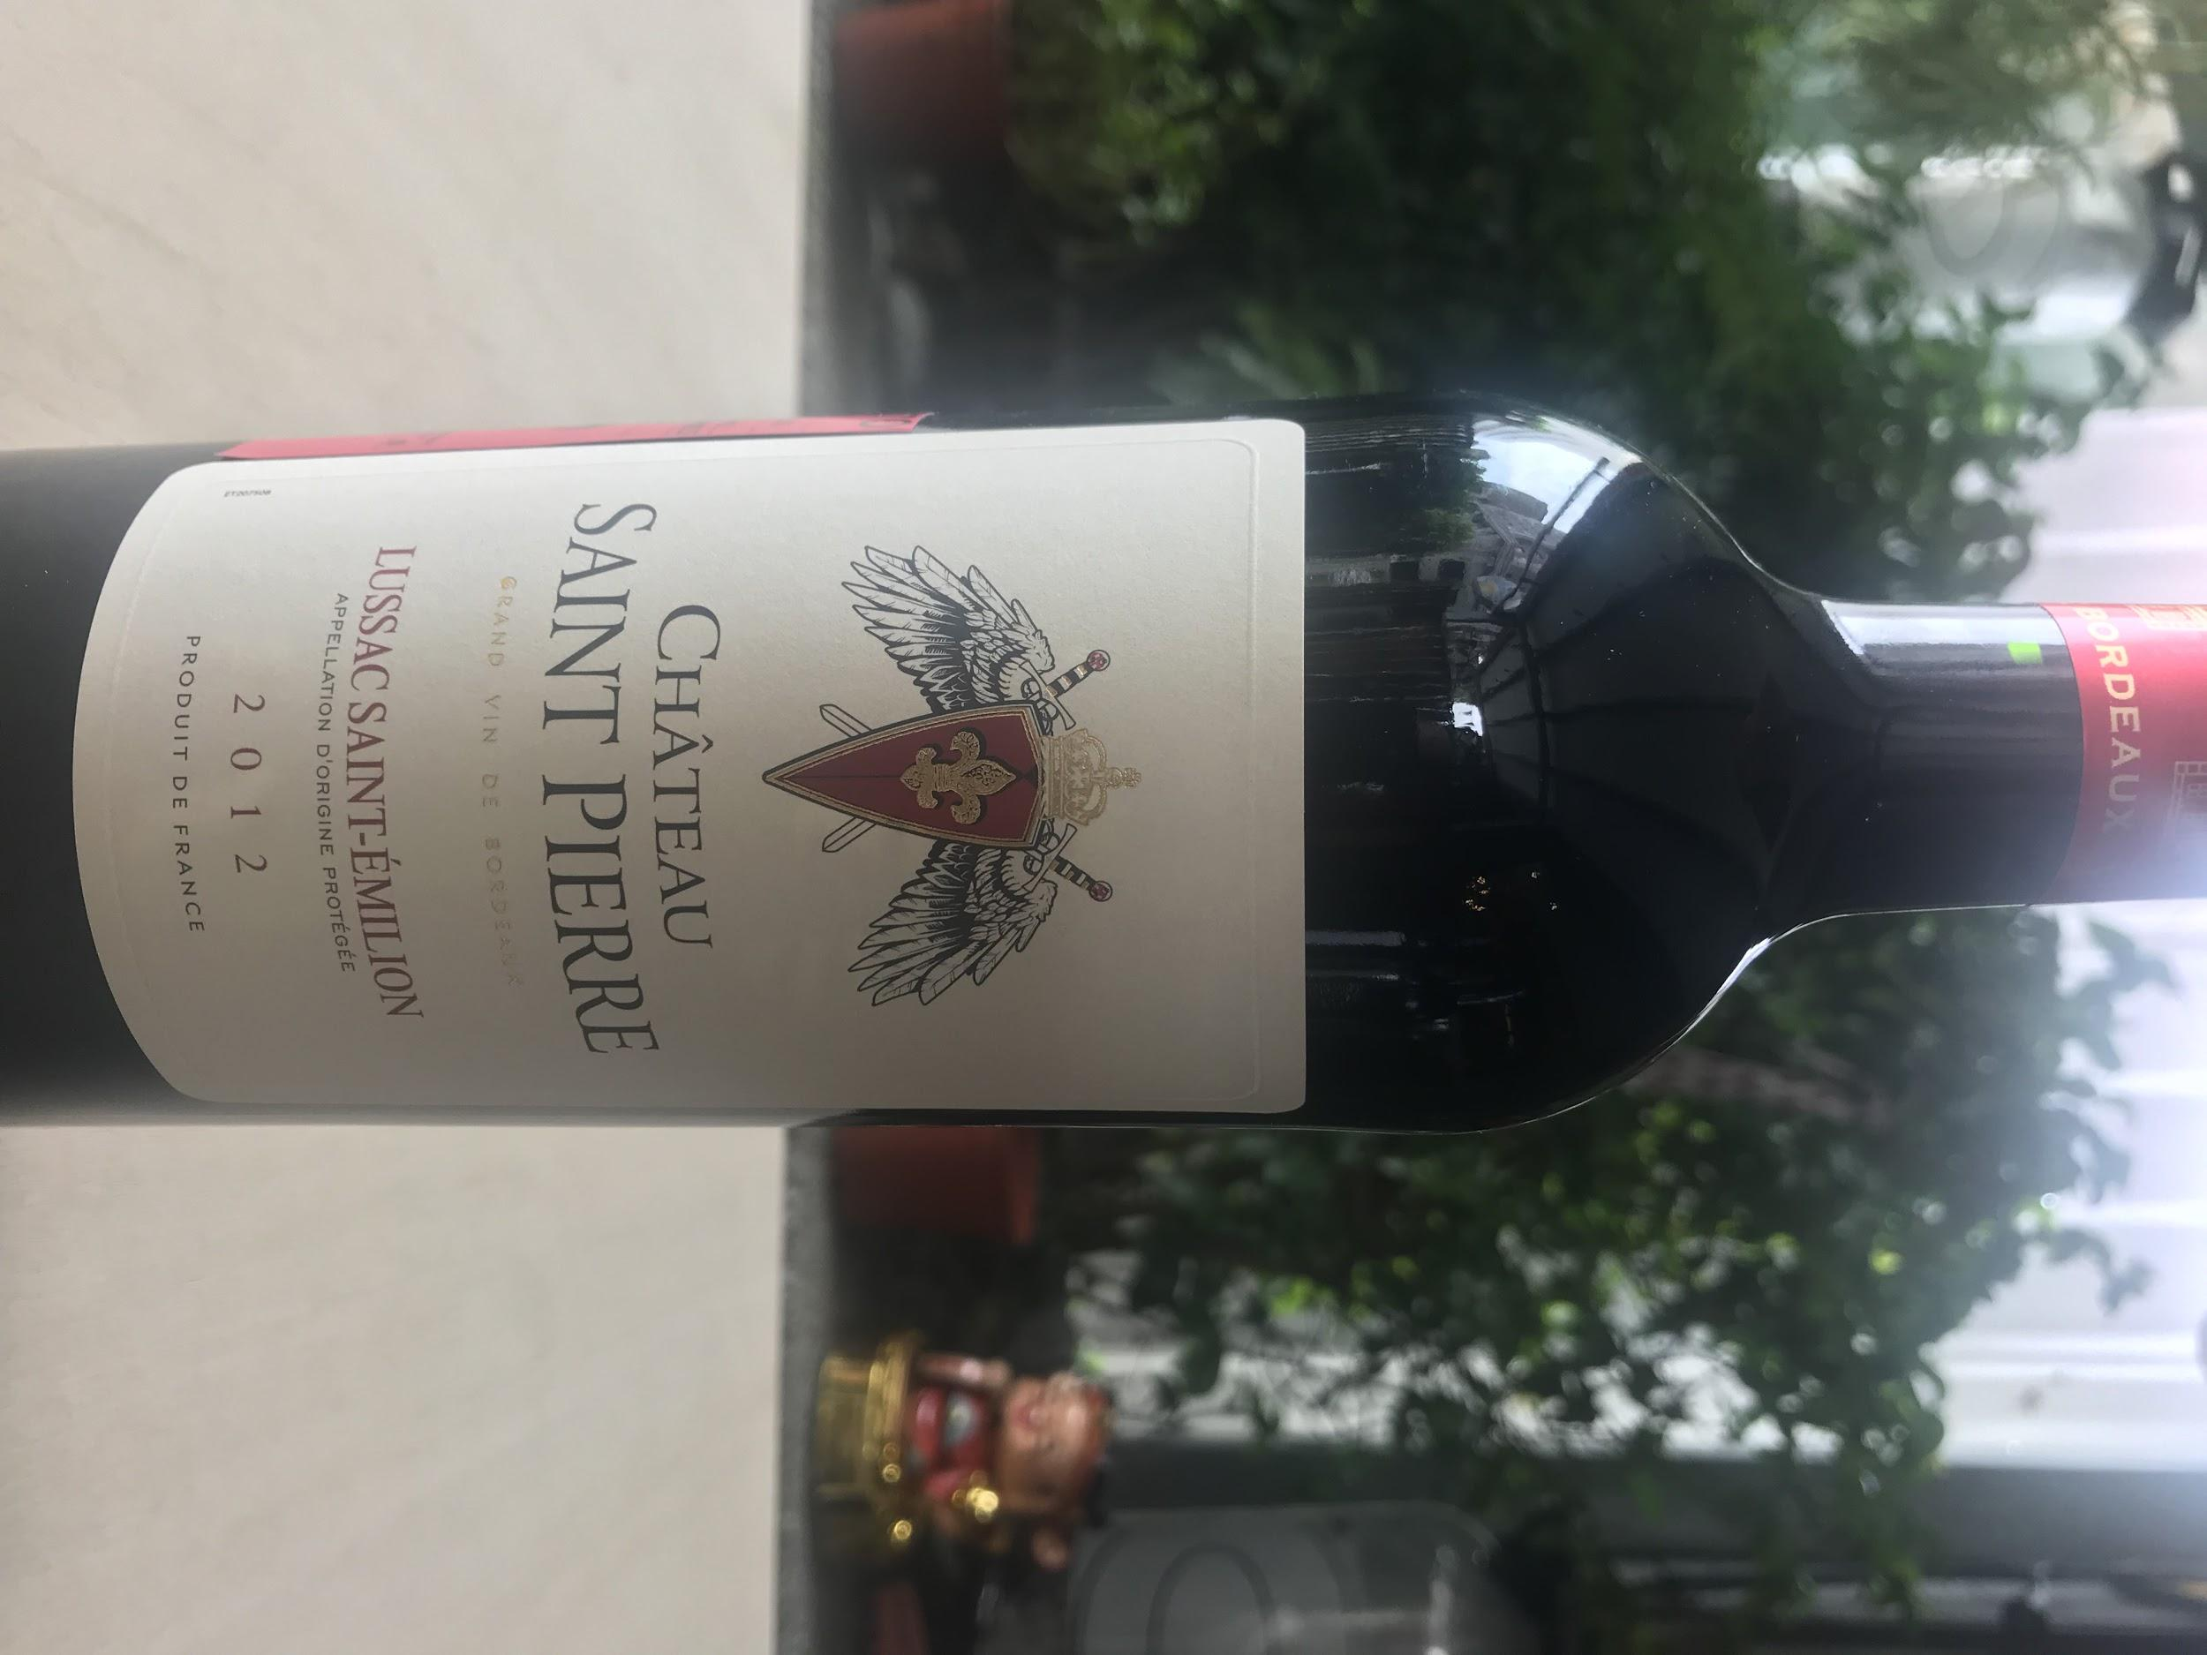
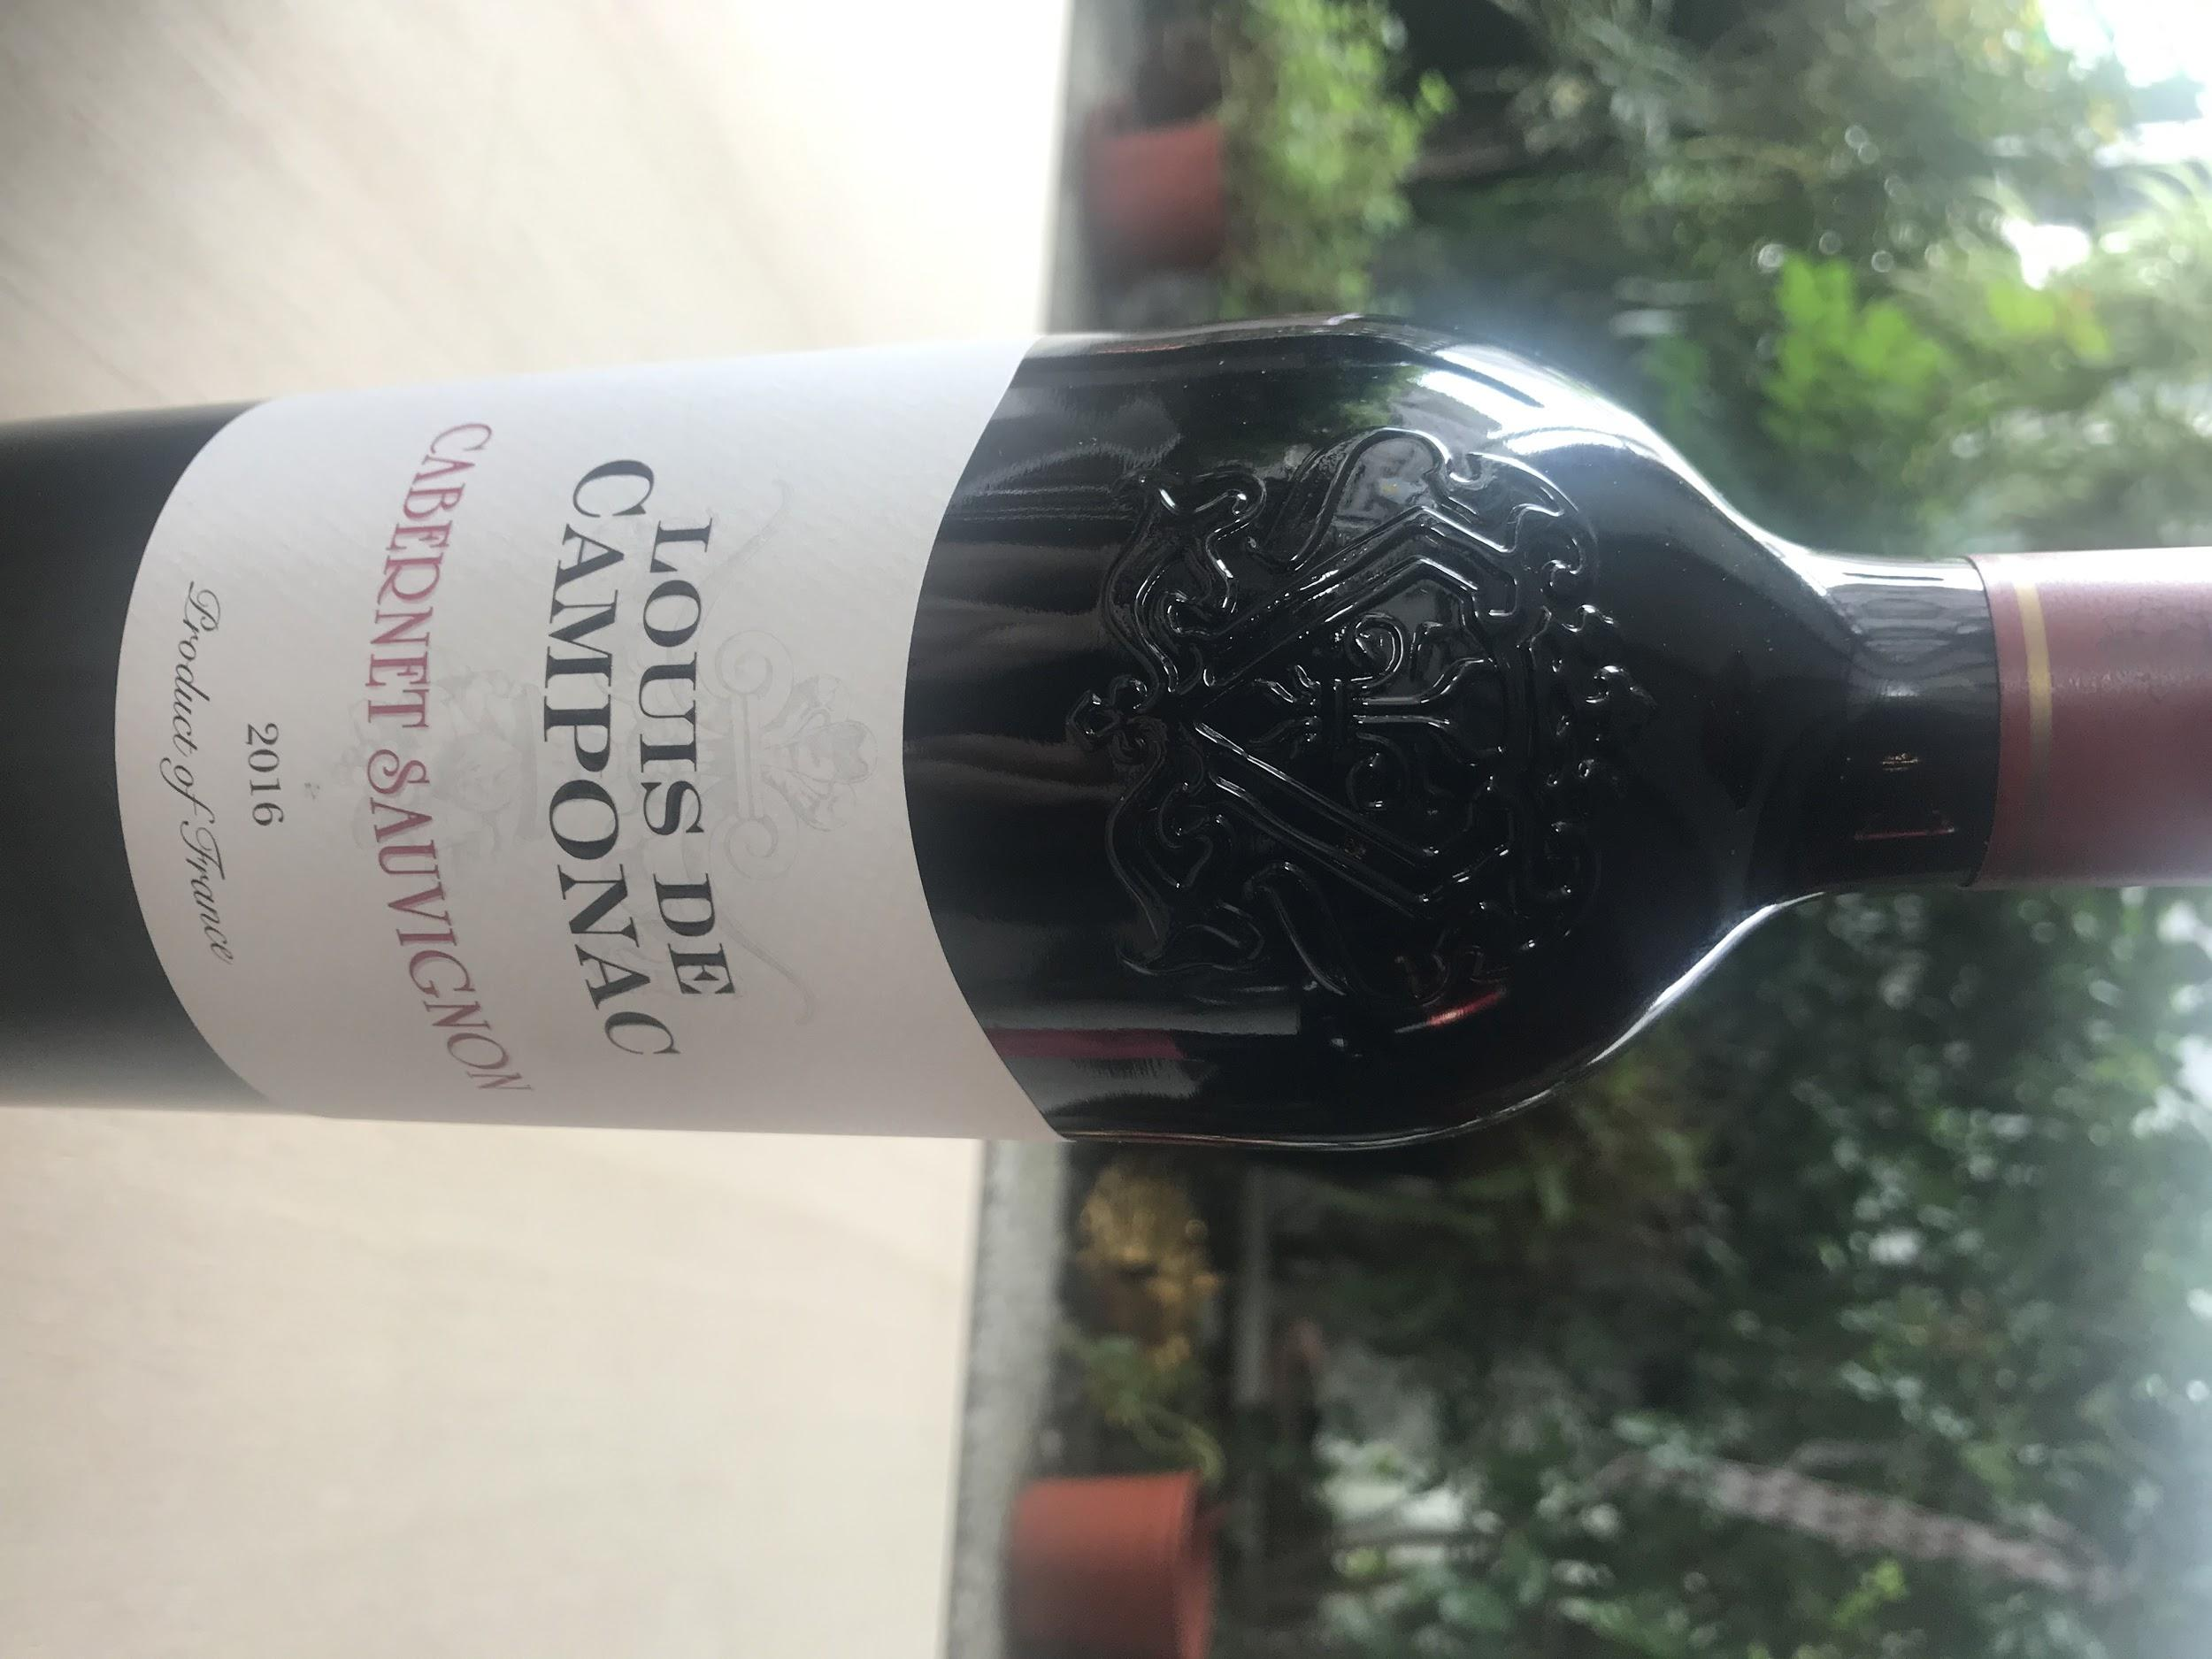
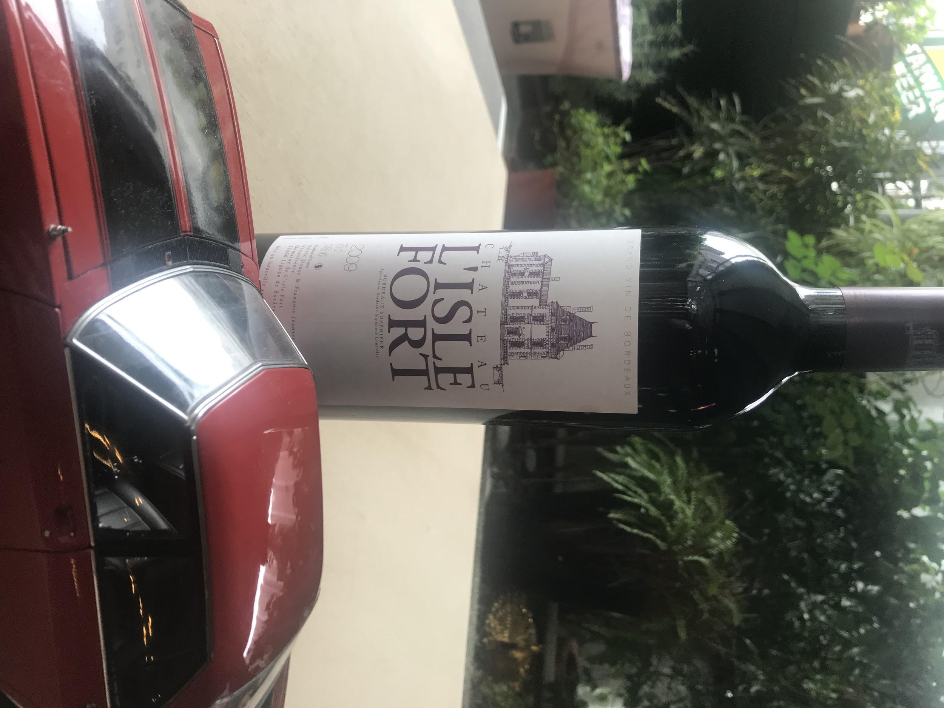
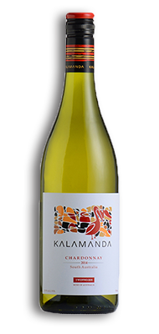
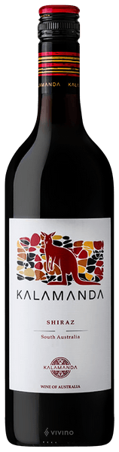
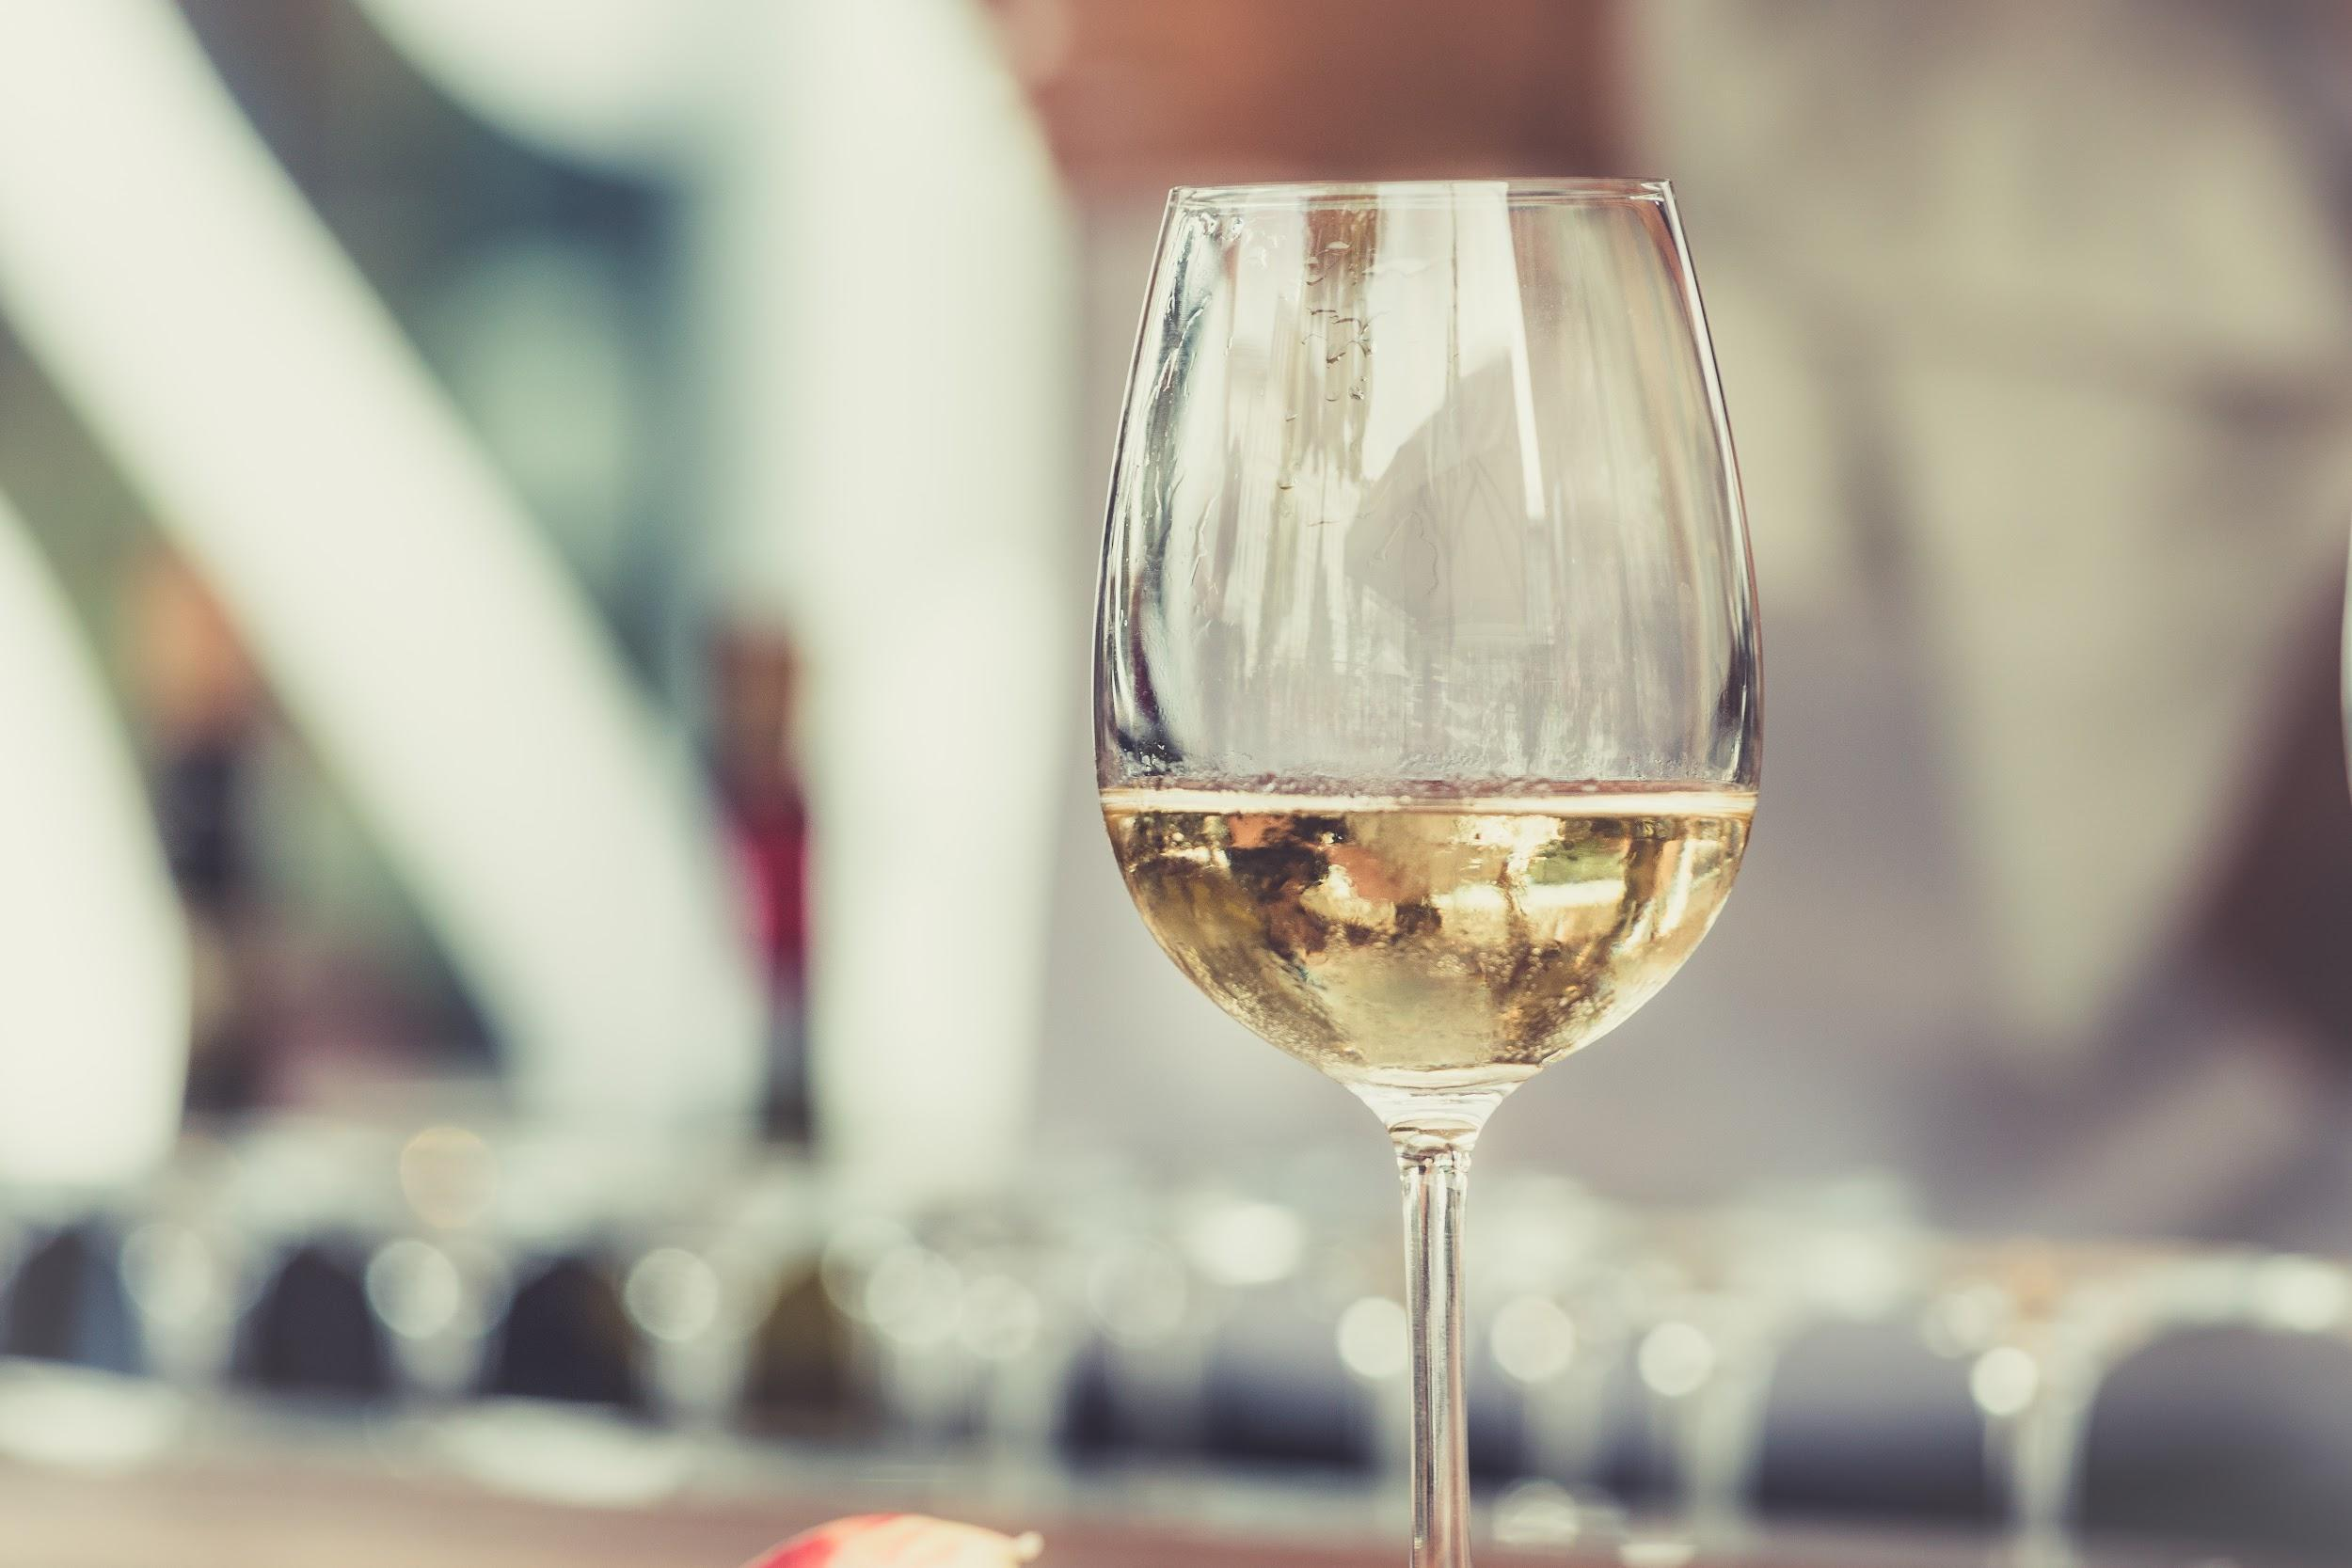
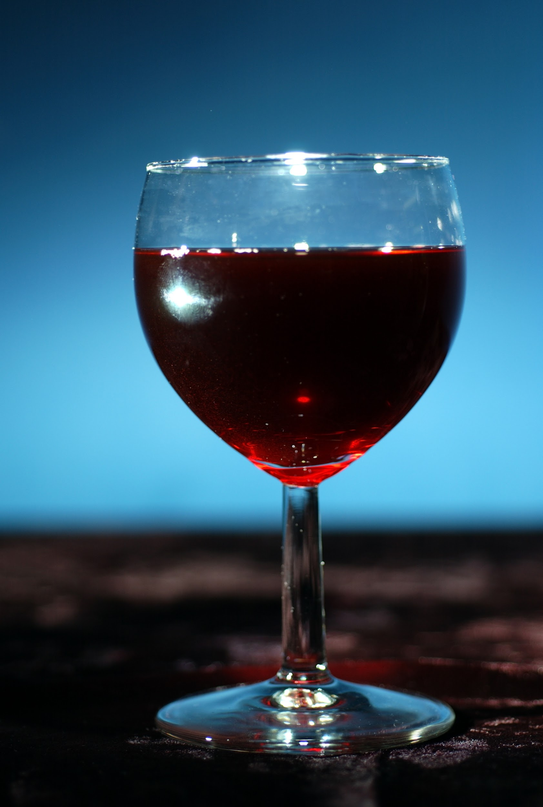
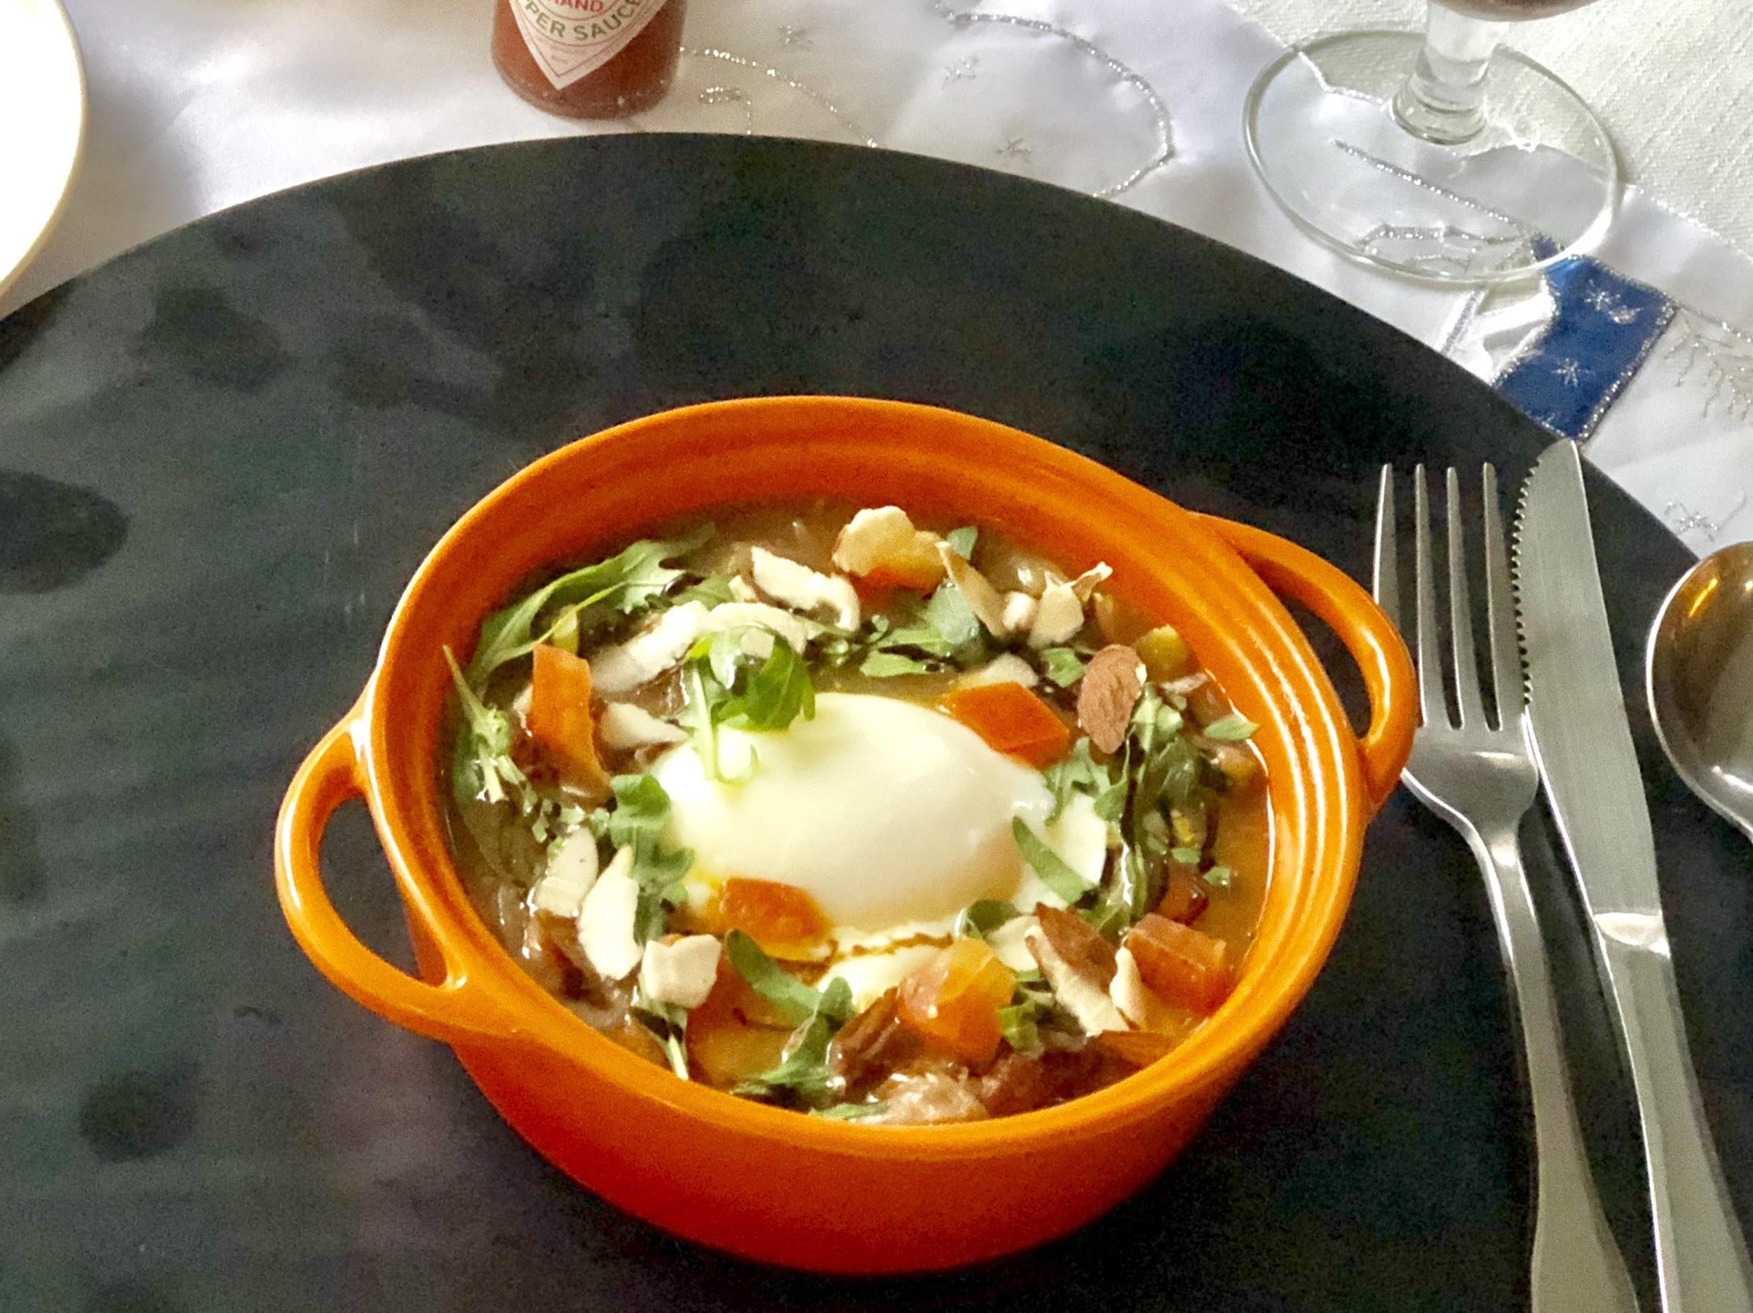
wine 紅酒
A meal without wine is breakfast
法國Clos Resseguier 2014 $1400
French, best paired with chicken or red meats slightly tanin easy on the palette also perfectly paired with cheese
低單寧、適合搭配紅肉、雞肉、起司
法國Château Saint Pierre 2012 $1400
French medium acidy with fruity overtures
Easy to drink. Red meats or cheese
波爾多頂級紅葡萄酒，果香濃郁、適合搭配紅肉或起司
法國Louis De Camponac 2016 $1100
Cabernet sauvignon moderately oaky with a taste of berries and peppery finish. Perfect paired with red meats or on its own
卡本內蘇維翁 Cabernet sauvignon，口感柔順飽滿，適合搭配紅肉
法國L'isle fort 2009 $1850
French from one of the best seasons a fine tasting wine with a touch of berry flavour, top choice
best paired with red meats
波爾多頂級紅葡萄酒，適合搭配紅肉或起司
澳洲卡拉曼達 希哈Kalamandra shiraz $1100
Australian 2016 slightly tanin, enjoy with red or white meats
搭配紅肉、白肉皆宜
澳洲卡拉曼達 夏多內
Kalamandra chardonnay$1100
Australian, crisp and refreshing
Enjoy with seafood, cheese, chicken and
hot summer days
適合搭配白肉或起司
Baron de Turis Spain/西班牙紅酒 $680
Red wine oaky and fruity
Baron de Breg Spain /西班牙白酒$680
White wine enjoyed with chicken,
seafood or cheese
House wine 單杯紅/白酒
Red- mon vin Merlot cabernet Italy $240 per glass
義大利梅洛紅葡萄酒
White- Hardys chardonnay Australia $240 per glass
澳洲夏多內白酒
本店消費需酌收10% 服務費Plus 10% service charge
Notes:
Salmon gratin mushroom steak cubes

Slide 5
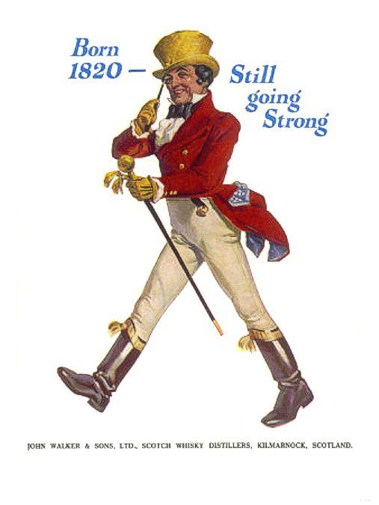
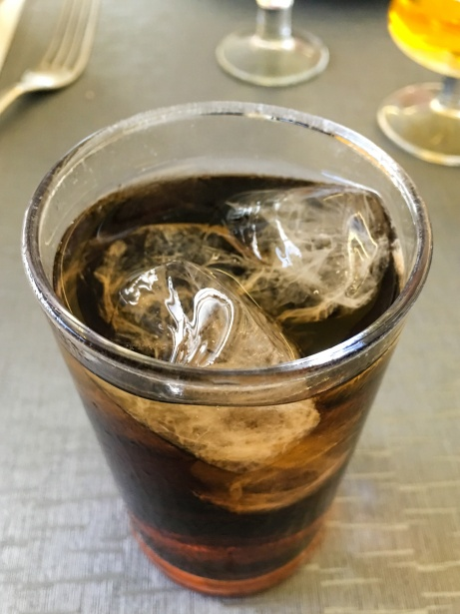
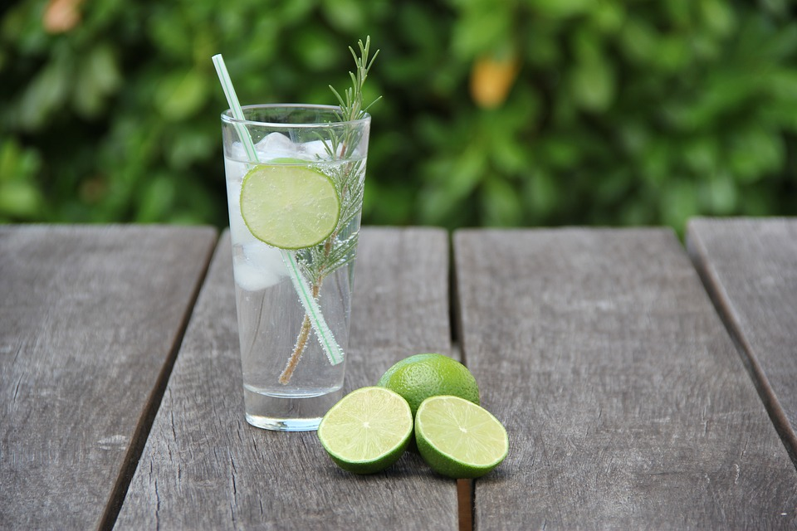
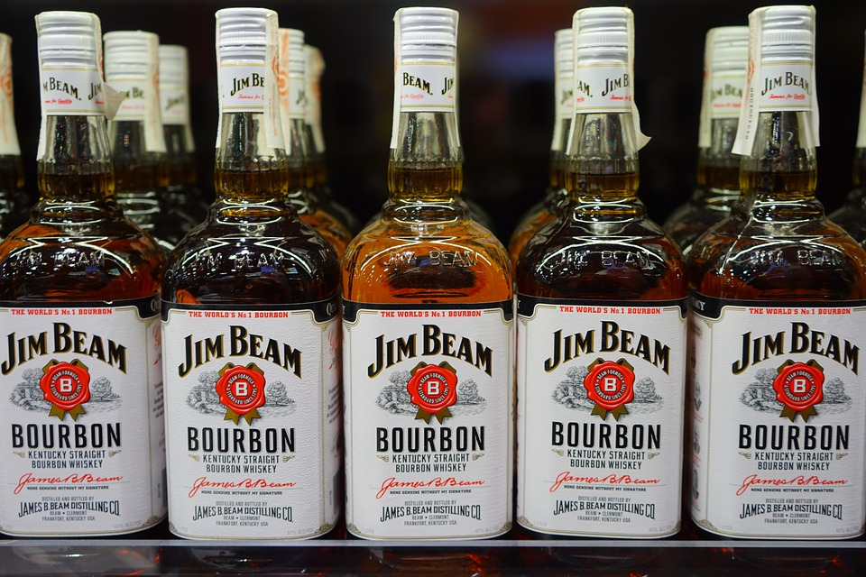
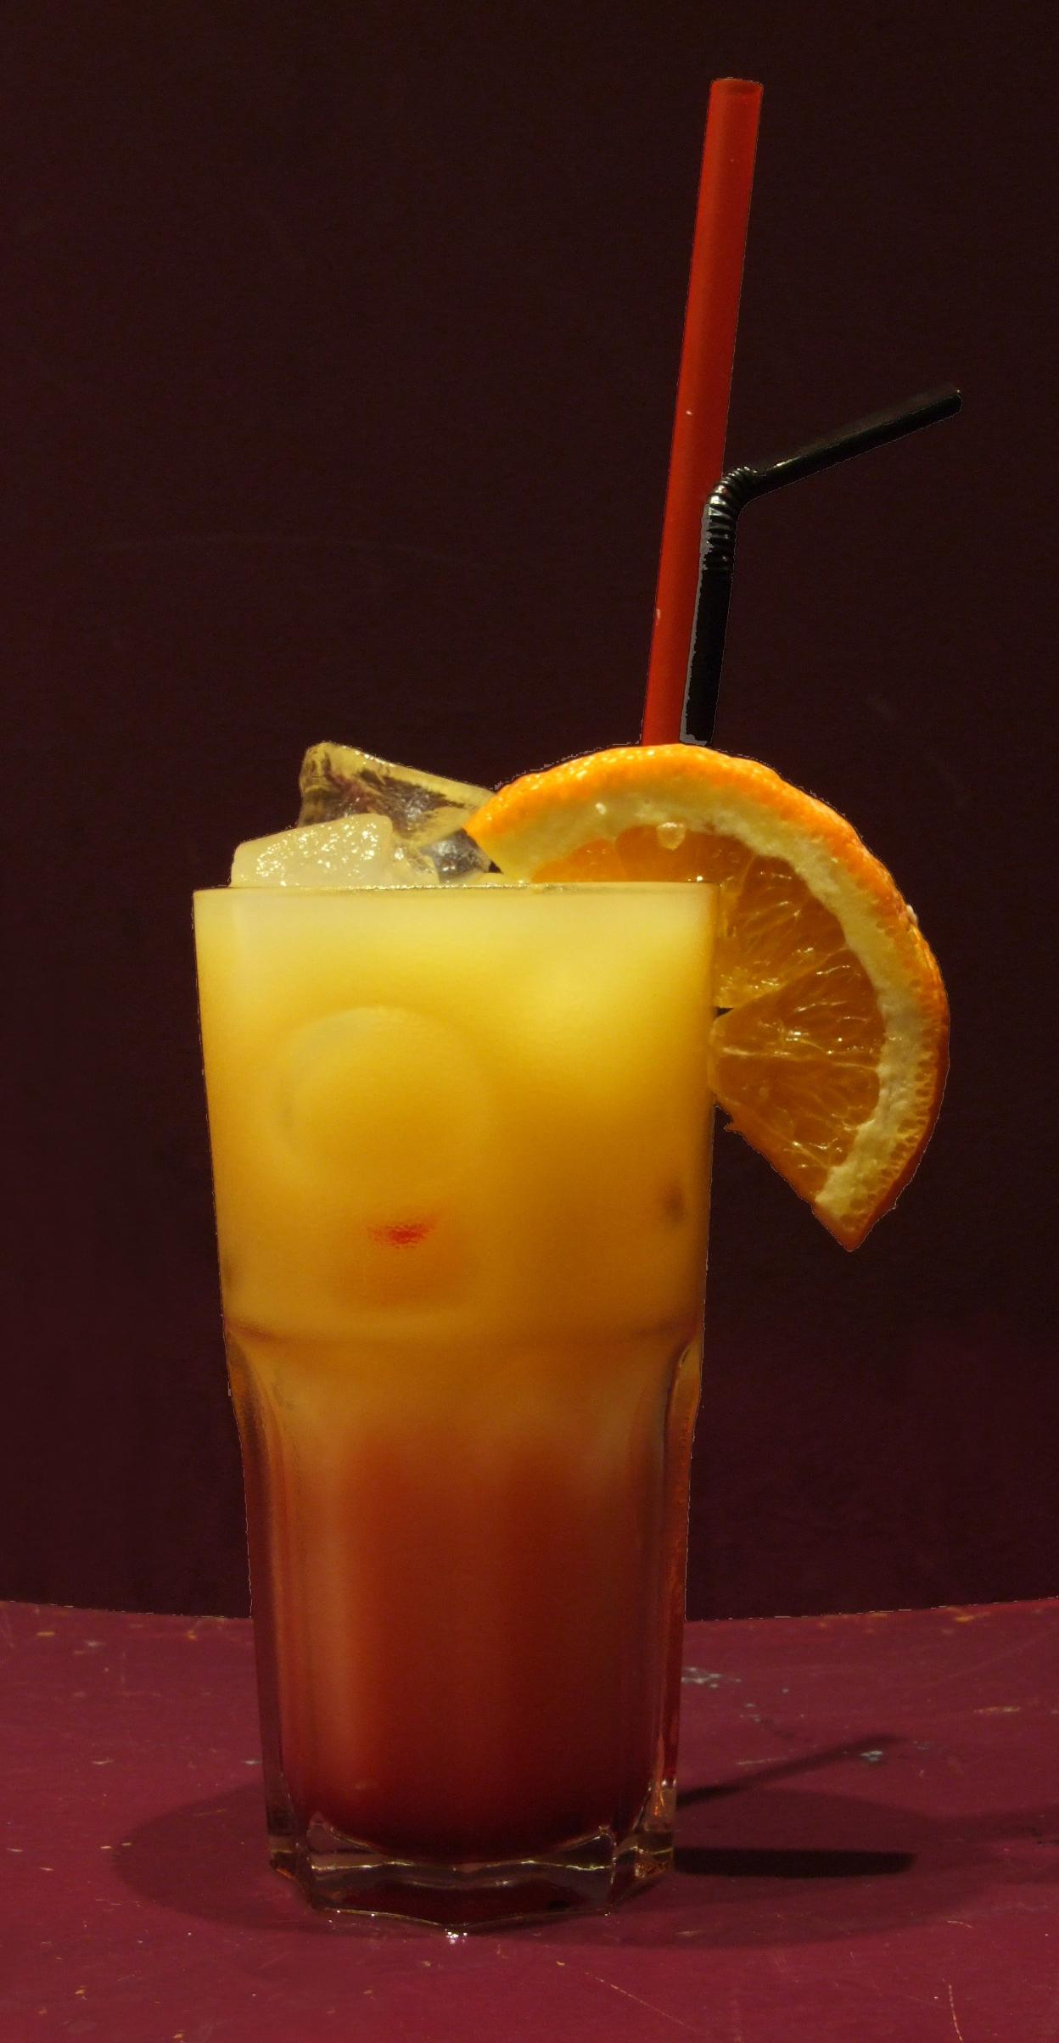
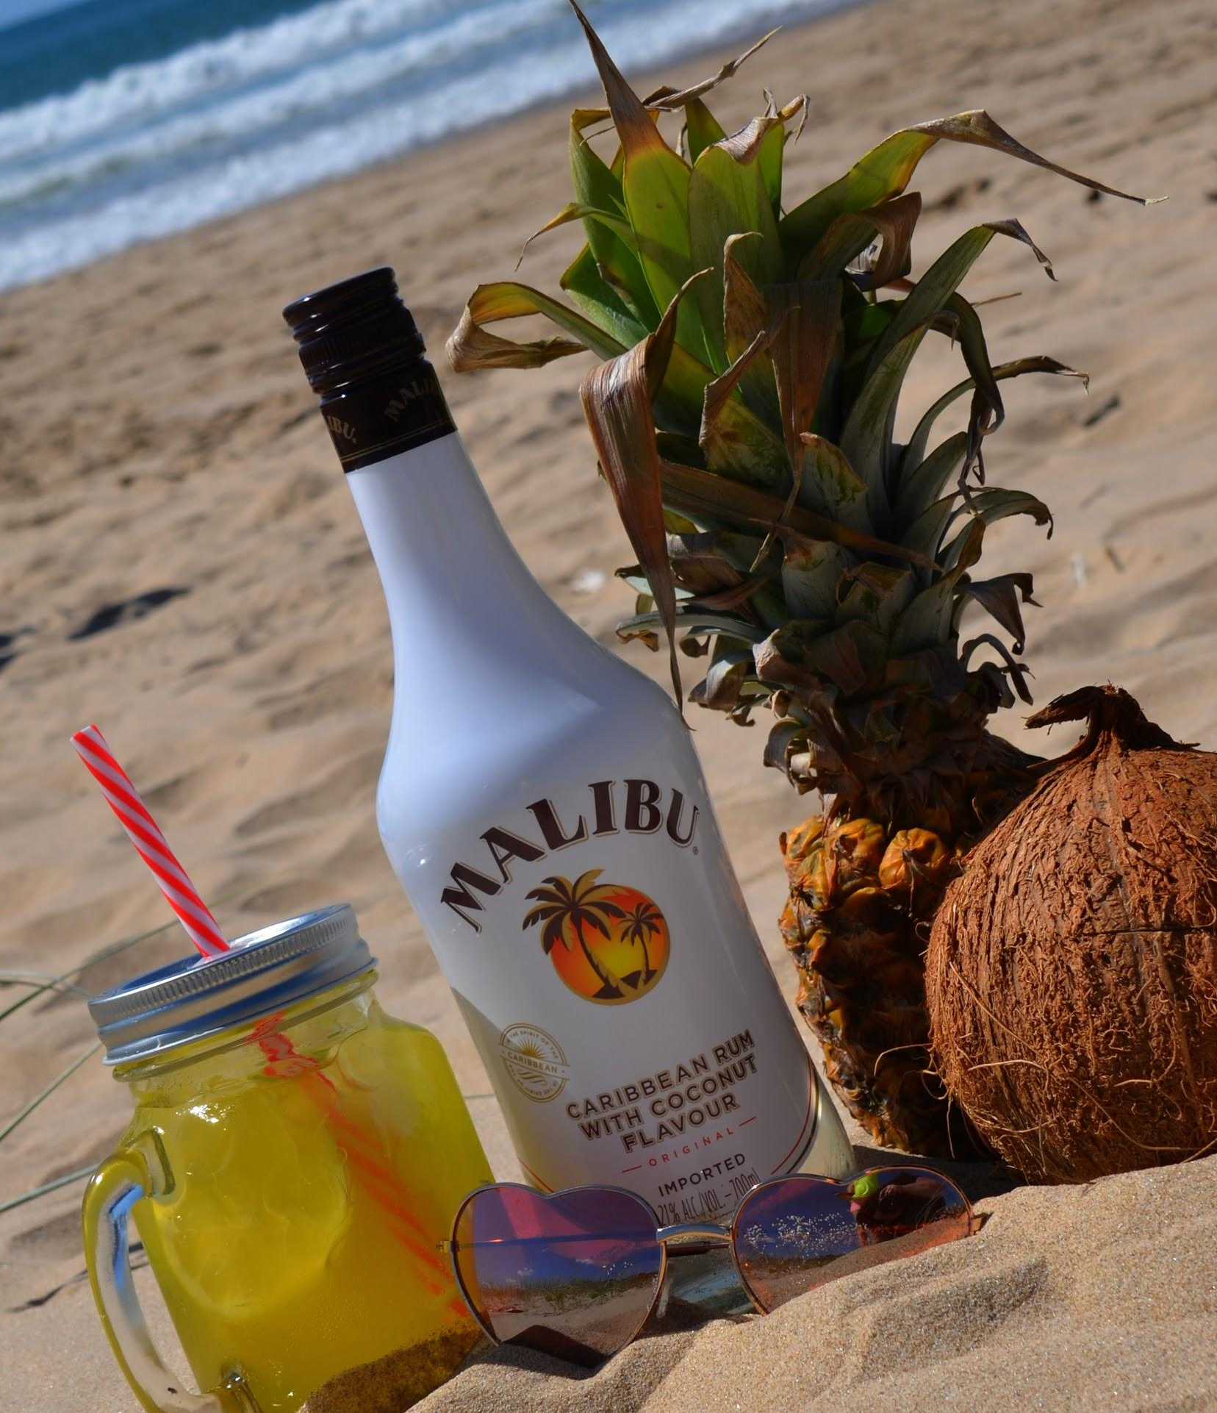
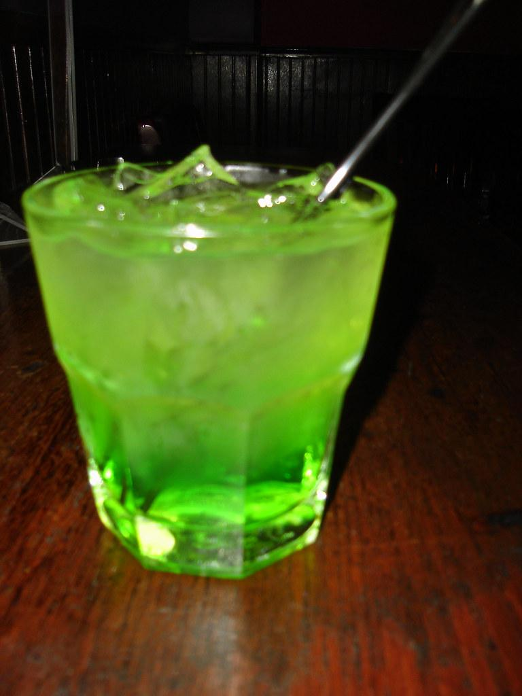
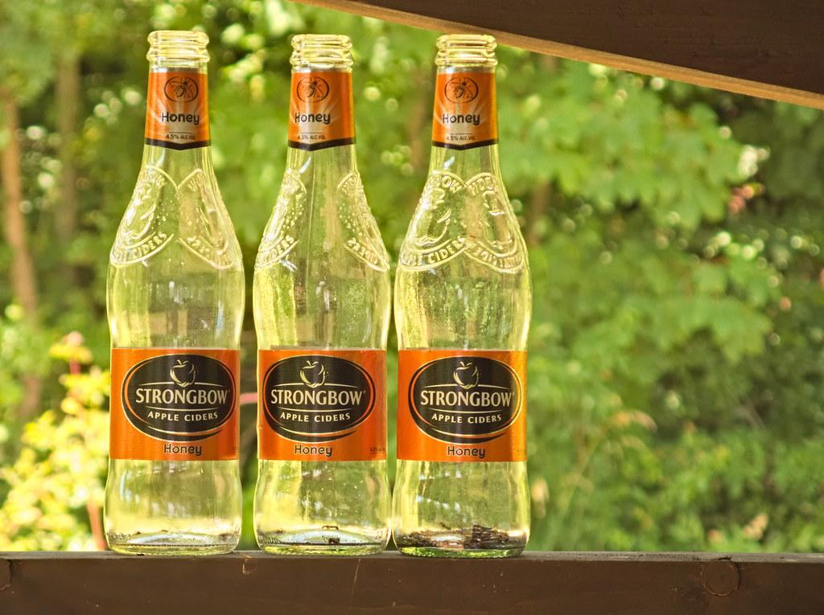
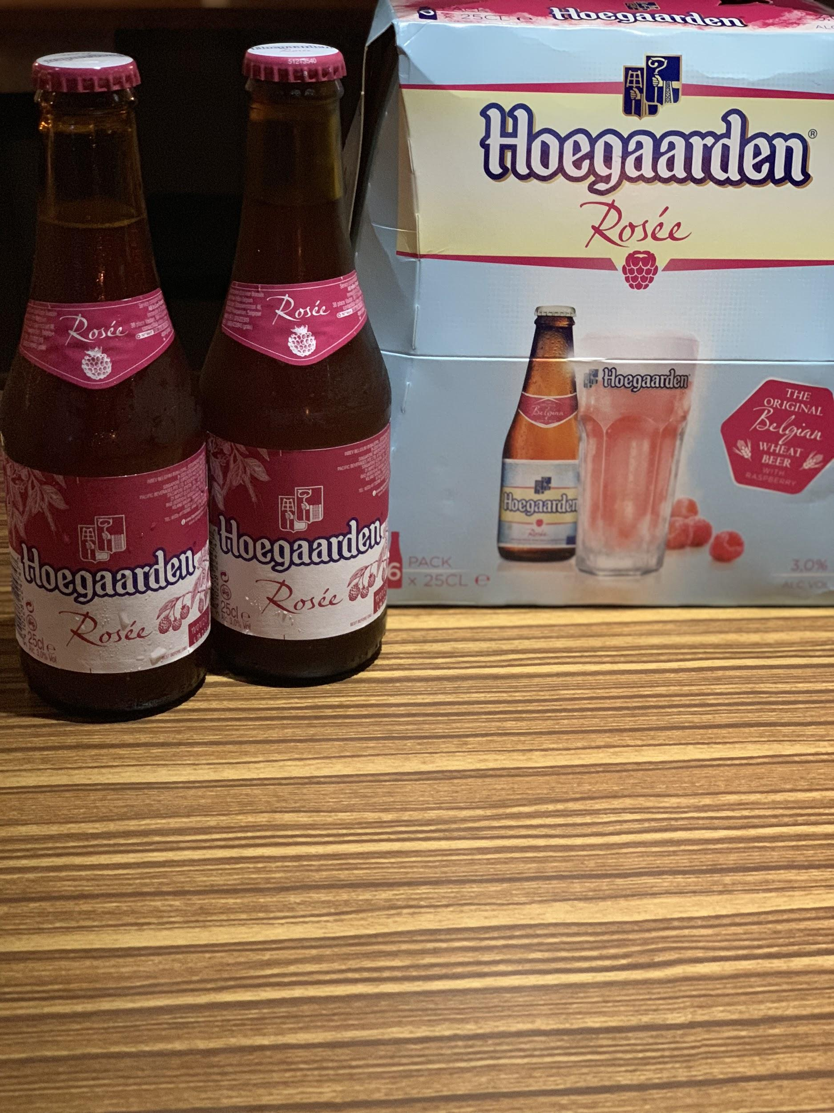
everyday favourites
relax with a cool drink at the YAK
scotch and coke $170
威士忌可樂
rum and coke $170
萊姆可樂
gin and tonic $170
金通寧
Jim Beam and soda $170
金賓蘇打
vodka sprite $170
伏特加雪碧
tequila and orange $190
柳橙龍舌蘭
malibu and lemonade $170
椰子檸檬汁
midori and soda $190
蜜瓜蘇打
bottled
strongbow gold apple $180
詩莊堡蘋果酒-金黃蘋果
strongbow elderflower $180
詩莊堡蘋果酒-接骨木花香strongbow red berry $180
詩莊堡蘋果酒-小紅莓hoegaarden rosee $190
豪格登覆盆莓小麥啤酒
Plus 10% service charge
Notes:
Salmon gratin mushroom steak cubes

